Slide 1
2004 boys track state champion 4 x 100 Relay team
Central Dewitt Hall of Fame
Induction Class 2021

Slide 2
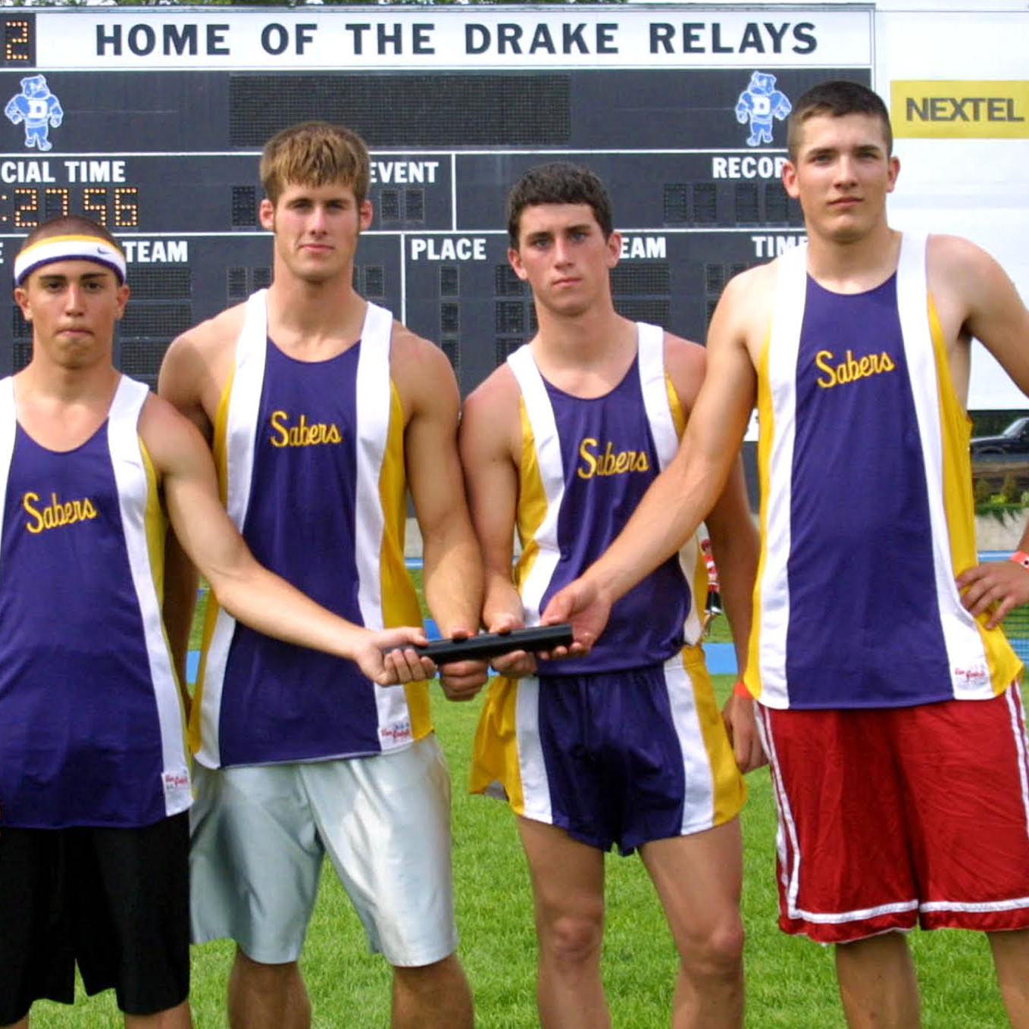
Inducted for Outstanding Contributions as a Team of Central dewitt High School

Slide 3
Biography
Our Track & Field program is arguably the most recognized and decorated sports program over the course of our school’s history. We have crowned a number of individual, relay and team champions since the program got its start in 1927. But not until 2004 would 4 young men, Sophomore, Nathan Comer, Juniors, Kyle Meade and Steven Jeffers and Senior Tyler Driscoll put together an incredible performance and earn the highly coveted 4 x100 State Track Title. They were Drake qualifiers in 2004 and broke a 30-year school record by running a 44.05. In the inaugural WaMaC meet the 4 x 100 would win the conference title and again set a new program and WaMaC record with Meade to Driscoll to Jeffers to Comer running a 43.9. They would become the first Saber quartet to better 44 seconds and top South Tama’s 1994 record by .04 seconds. At State they would again break their own school record in the prelims, running a 43.82 to qualify for Saturday’s finals where they would earn the school’s first ever 4 x 100 State Title. Coaches for the 2004 Boys Track team were: Head Coach Tom Meade, Coach Andrew Vickers, Coach John Betz and Coach Jared Block.

Slide 4
Article from the Observer
The goal was to post a time of 43.50.
The 2004 Central DeWitt boys 4x100 relay team had already run under 44 seconds in each of its previous two races and, with a smooth set of handoffs and tough competition pushing them, another record performance was possible.
Ultimately, the Hall of Fame quartet of Kyle Meade, Tyler Driscoll, Steven Jeffers and Nathan Comer could not quite reach their goal time. And it did not mean a lick. Because the Sabers team accomplished something way better: A state championship.
Seeded fourth in the race, the crew reached the finish line first, winning the 3A state championship — the program’s first in the event — with a clocking of 43.86. While the time was not quite 43.50, it was still the second-fastest performance the quartet produced all season. Or as Jeffers put it after the race: “It wasn’t our fastest, but it was fast enough. As long as we’re state champs, I don’t care what our time was.”
It was the capper to a unique spring. The Iowa High School Athletic Association decided that, in 2004, teams in Class 2A and Class 3A would qualify for the state meet at a district meet, rather than by hitting qualifying standards throughout the year.

Slide 5
The Observer (cont.)
The change caused second-year head coach Tom Meade to scale back Central DeWitt’s schedule — wherein most years the Sabers would compete in 11 or 12 outdoor meets before state, this time they would compete in just seven.
The goal was to peak during the final three meets of the season: the 3A district (state-qualifying) meet, the WaMaC Conference meet and the state meet. The strategy worked like a charm for the 4x100 team. After three meets with times hovering just under 45 seconds — including a clocking of 44.98 at the Drake Relays where the quartet switched up their lineup to their eventual state-winning form (Driscoll and Comer swapped spots) — the group surged late.
That momentum included a performance where the relay team broke the school record of 44.30 set in 1972 with a time of 44.05 at the Western Dubuque Invitational.
The Sabers followed it up by running 44.18 to earn runner-up honors and qualify for the district meet. Bigger things were still to come.
First, the quartet became the first Central DeWitt 4x100 team ever to finish under 44 seconds with their clocking of 43.90 at the WaMaC meet (held after the district meet). It was the Sabers’ debut in their new conference and the 4x100 title — the time broke the decade-old conference record by South Tama — helped them claim the team crown in their first year.

Slide 6
The Observer (cont.)
The record dropped a final time in the prelims of the 4x100 at the state meet with the foursome running a 43.82.
A day later, the Sabers saved their best for last, topping the three squads that qualified ahead of them in the prelims, including a Dubuque Wahlert squad relay team that entered state with the class’s top time and had defeated the Sabers at the district meet two weeks earlier.
“I never thought about being a state champ,” said Driscoll, the lone senior on the squad. “I knew we had a good team, but realistically, I didn’t think we could win, especially after they (Wahlert) were so far ahead of us at districts.” But if anybody was going to do it. It was going to be this hard-working group.
“Those four guys wanted to do well,” Coach Meade said. “They spent a lot of time preparing for today.” “Every day this whole year I kept telling those guys we could win a state championship,” the younger Meade added. “We just all came together today and worked hard and it all came together.”

Slide 7
Induction speech
Inducted for Outstanding Contributions as a Team
Our Track & Field program is arguably the most recognized and decorated sports program over the course of our school’s history. We have crowned a number of individual, relay and team champions since the program got its start in 1927. But not until 2004 would 4 young men, Sophomore, Nathan Comer, Juniors, Kyle Meade and Steven Jeffers and Senior Tyler Driscoll put together an incredible performance and earn the highly coveted 4 x100 State Track Title. Longtime and legendary coach Tom Meade had coached in the Saber track program since 1979, but in the spring of 2004, he would now be in his second year as the program’s Head Coach. We were also competing in our first year of the new WaMaC Conference and additionally, the Iowa High School Athletic Association had adopted a new system for the qualification of State participants, now based on District meet results. As a result, Coach Meade would implement some “old school” philosophies and enter individuals and teams in fewer meets, with the anticipation of getting peak performances and remaining healthy down the stretch. The program had experienced recent success, finishing in the top 10 at State from 1999-2002, but injuries had ended the string of top 10 State finishes with a 27th place finish in 2003 and after a string of 4 straight Big Bend Conference team titles, rival Western Dubuque had captured the title in 2003. The 4 x 100 team was instrumental in the resurgence of the Saber program that season. They were Drake qualifiers in 2004 and late in the season showed signs that they were peaking by winning at our own Saber

Slide 8
Speech (cont.) & video
Invitational and a few weeks later at the Bobcat Invitational, breaking a 30-year school record by running a 44.05 once held by Roger Gerdes, Ed Malmanger, Terry Gholsen and Tom Peters from 1972. They would take that momentum into the District Qualifier and again reset the school record, while placing 2nd and qualifying for the State meet behind the winning team Dubuque Wahlert. That same 4 x 100 quartet would need to rebound after big disappointment, as they were poised to qualify in the 4 x 200 but would be disqualified during that event. In that first ever District meet, the team would finish 4th and qualify 13 to State. The inaugural WaMaC meet would be run after Districts and Coach Meade’s strategy to peak at the right time paid off as the team would win the WaMaC team title in their first year in the conference, winning 4 events and scoring in 16 of 17 events to score 85 points and topping host and another conference newcomer, Western Dubuque by 11 points who had taken the last Big Bend title from the Sabers the year before. Again, the 4 x 100 would win and set a third straight program and WaMaC record with Meade to Driscoll to Jeffers to Comer running a 43.9, the now 3rd fastest time in 3A. They would become the first Saber quartet to better 44 seconds and top South Tama’s 1994 record by .04 seconds. At State they would again break their own school record in the prelims, running a 43.82 to qualify for Saturday’s finals and set a goal to run a 43.5 and beat nemesis Dubuque Wahlert. They would not run their fastest time but would beat Wahlert and earn the first ever 4 x 100 State Title! Nathan Comer was a 4X Track Letterman and Captain. He ran on 4 x

Slide 9
Speech (cont.) & video
100 teams were 2X Drake Qualifiers, State Champions in 2004, 2nd in 2005 and 7th in 2006. He earned 2005 State medals in the 200-meter (5th) and 4 x 200 (4th). He broke the 200-meter school record and was part of 3 WaMaC Champion Relay teams and a 2X individual medalist. He was a 2X Football Letterman, Captain, All-District Honorable Mention selection and Shrine Bowl participant. He earned his Eagle Scout in 2006 and was in the Band, FCA and member of the Honor Roll. He went participated in FB & Track at Platteville University and has been a Scott Country Sherriff since 2009. He is married to wife Terrie and has three children, Olivia (11), Henry (2) and Hugh (1). Steven Jeffers was a 2X Track Letterman and ran in the 4 x 100-meter Relay twice at Drake. He was part of 2, WaMaC Championship Relay teams and earned 2 other Individual Conference medals. He had individual success in the 200-meter, 400-meter as well as regularly finishing 1st or 2nd in the Long Jump. He was a 2X Football Letterman, All-District Honorable Mention and All-Area Football team selection. He is long remembered for his 2003 football Playoff highlights while blocking the extra-point to secure a 21-20 football team win at the UNIDome and returning a blocked punt for touchdown in the Quarterfinal game vs. Mt. Vernon. Steven and fiancé Jenna are raising 5 children, Bryce (6), Graham (7), Haylee (9), Mia (10) and Sydney (16). Kyle Meade was a 4X Track Letterman. He ran on 4 x 100 relay teams were 2X Drake Qualifiers, State Champions in 2004 and 2nd in 2005. He also ran in the 2005 4th place 4 x 200 relay. Individually in the 100-meter, he was a Drake Qualifier and placed 9th in 2003 and 3rd in 2005. In

Slide 10
Speech (cont.) & video
2005 he broke Chuck Runge 28-year old 200-meter record. He earned 6 WaMaC Conference medals including 3 1st place in the 4 x 100, 4 x 200 and 100-meter Dash. He was a 2X Football Letterman, 1st Team All-District, All-District Academic and All-Area Football team selection. He was in the Band, Student Council and Honor Roll student. He received Psychology & Art degrees from the University of Iowa and is currently an Art Director of a design agency in New York City. A 2015 Saber Hall of Fame inductee, Tyler Driscoll earned 9 Varsity Letters, was the 2004 Bernie Saggau Award winner, Yearbook Editor, member of NHS and Student Council. He was a team Captain for Football, Basketball and Track. He was a 2X Drake Relay medalist and qualified for 11 State Track events, medaling 3 times. He was a 2X first-team All-District football selection, Captain of the Eastern Iowa team, INA & Des Moines Register First-team All-State and Shrine Bowl participant. At St. Ambrose University he earned a Criminal Justice degree and was a 4X football Letterman, earning All-Conference & NAIA All-American honors. He is a supervisor and educator for the Department of Homeland Security: US Customs and Border Protection. Coaches for the 2004 Boys Track team were Head Coach Tom Meade, Coach Andrew Vickers, Coach John Betz and Coach Jared Block. Please help me welcome the newest members of the Central DeWitt High School Hall of Fame, 2021 inductees… The 2004 Boys 4 x 100-meter State Champion Relay Team with Nathan Comer, Steven Jeffers, Kyle Meade and Tyler Driscoll.

