Slide 1
2009 boys track state champion 4 x 100 Relay team
Central Dewitt Hall of Fame
Induction Class 2022

Slide 2
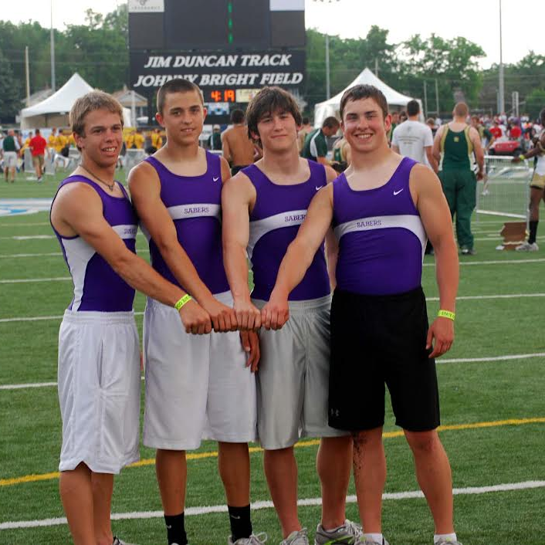
Inducted for Outstanding Contributions as a Team of Central dewitt High School

Slide 3
Biography
In 2009 the 4x100 Relay had a lot of pressure on their shoulders at the state track meet. Winning the state track team title came down to this race. With no seniors in the race, the quartet of Alex Dalldorf, Ryan Daniels, Joe Feldpausch, and Ben Comer were nervous but up to the task. They qualified for the finals by running a 43.54 which was not only the fastest prelim time but also the second fastest time in school history. In the finals the quartet knew they had to place first or second to bring home a state team title. As the race began each coach was not only watching the relay but each exchange zone official to make sure no yellow flags went up. The quartet put together an incredible performance bringing home the relay title and a state team title as well. It was the second 4x100 relay state title in school history. Coaches for the 2009 Boys Track team were: Head Coach Jered Birt, Coach Ryan Streets, Coach Tony Foxen and Coach Jared Block.

Slide 4
Article from the Observer
There are no buzzers to beat or final outs to get. But there are still clutch performances in track and field. Just ask the 2009 Central DeWitt boys 4x100 relay team. With just two events remaining in the state track and field meet, the Sabers sat seven points behind Algona, 51-44, in the 3A team standings.
The Bulldogs’ weekend was done, but Central DeWitt had one more opportunity to make up the difference. They would just need to finish at least second to do it. Instead, the quartet of sophomores Alex Dalldorf and Joe Feldpausch and juniors Ryan Daniels and Ben Comer clinched the Sabers’ title in style, winning their own state crown in 43.65.
Boone and Hampton-Dumont rounded out the top-three, but neither squad was within two-tenths of a second of Central DeWitt. “I looked around and there was nobody around me,” Comer said of his anchor leg. “It felt great.”
Head coach Jered Birt did not inform the quartet of the added stakes, but he had a feeling they already knew what hung in the balance. “I didn’t talk to them,” he said, “but in this age of cell phones, I think they got the message about what they needed to do.” The quartet’s first appearance on Drake Stadium’s famous blue oval proved to be its launching point.

Slide 5
The Observer (cont.)
The foursome earned one of the last 16 — out of 80 — spots in the Drake Relays field, but ultimately won their heat and finished 32nd in a season-best 44.64. By the next meet, the Sabers were under 44 seconds and proceeded to win three of their next four races, including a clocking of 43.96 at the state-qualifying meet that ranked fourth among 3A squads.
All four members of the relay were busy in Des Moines: Dalldorf competed in both the 100- and 200-meter dashes and teamed with Feldpausch and Comer (along with Brandon Jasper) to set a school record in the 4x200 relay. Feldpausch and Comer were also part of the Sabers’ 4x400 team, while Daniels ran a 200-meter leg on Central DeWitt’s distance medley team.
They were at their best together, however, and proved it in the 4x100 prelims on Friday. Setting the stage for the title-winning performance that followed, the quartet ran the fastest time of the prelims — a clocking of 43.54 that doubled as their fastest of the season. A day later, even with all the event’s inherent uncertainty, Birt knew his team’s fortune was in good hands. “The 4x100 is a race where a lot of things can go wrong,” he said. “It was nice having a group that was so consistent.”
If the first state championship did not convince you, the second one sure did.

Slide 6
Induction speech
Inducted for Outstanding Contributions as a Team
In 2009 the 4x100 Relay had a lot of pressure on their shoulders at the state track meet. Winning the state track team title came down to this race and they had to place first or second to jump ahead of other schools total points. Coach Birt remembers calculating the points in the stands prior to the race with coaches and teammates. “We knew the team race was close and the four schools in the hunt did not have a 4x400 that qualified for the finals. We didn’t want the boys to know they had to get first or second and have that added pressure” but with cellphones they found out in a few seconds from teammates. The quartet qualified for the finals with a 43.54 and would be in lane 4 for the finals. The prelim time was their fastest time of the season. The time was also the second fastest in school history to date. Waverly-Shell Rock and Mount Pleasant were only 1/10th of a second behind. What Waverly and Mt. Pleasant didn’t have was a team title hunt motivating them. The quartet of Sophomores, Alex Dalldorf and Joe Feldpausch, and Juniors, Ryan Daniels and Ben Comer put together an incredible performance winning the 4x100 Relay State Track Title and securing a State Team Title. Please help me welcome the newest members of the Central DeWitt High School Hall of Fame, 2022 inductees… The 2009 Boys 4 x 100-meter State Champion Relay Team with Alex Dalldorf, Joe Feldpausch, Ryan Daniels, and Ben Comer.

