Slide 1
Adam Grell
Central Dewitt Hall of Fame
Induction Class 2019

Slide 2
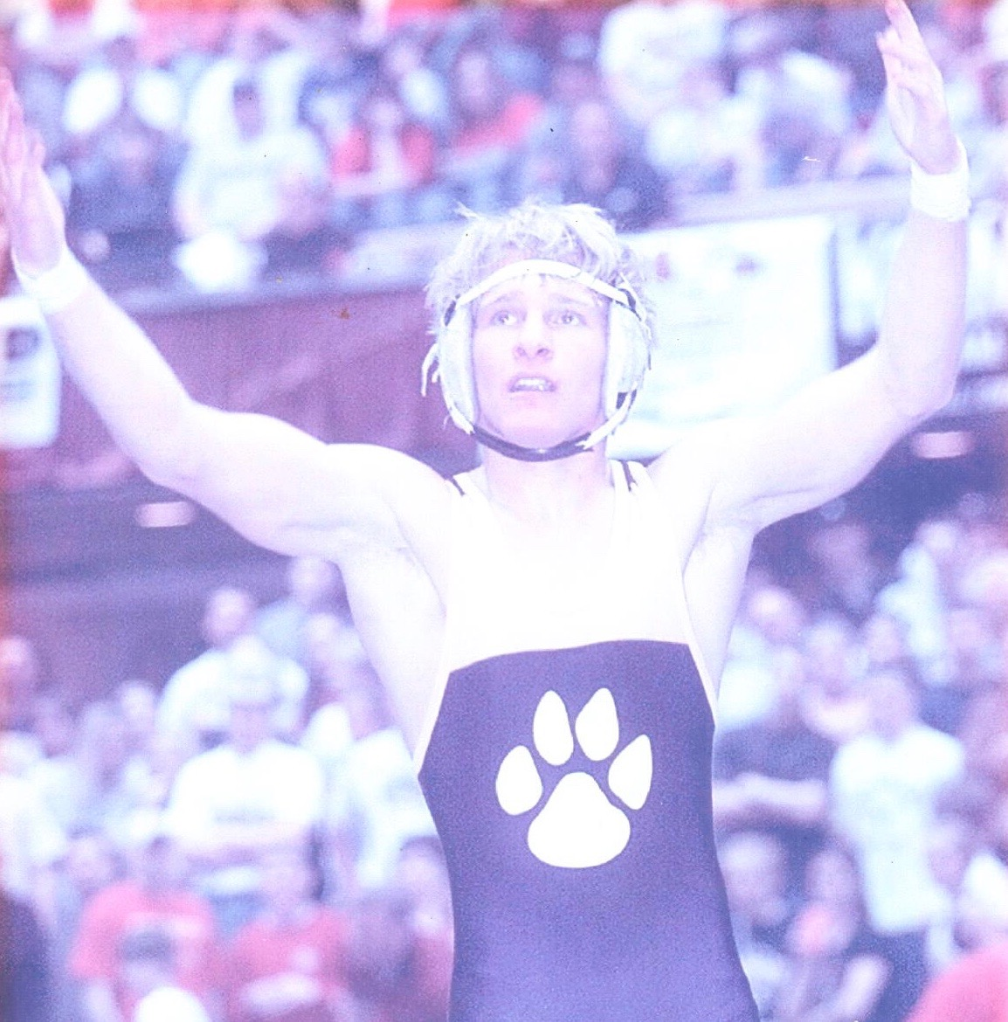
Inducted for Outstanding Contributions as an individual of Central dewitt High School

Slide 3
Biography
Adam Grell is a 2002 graduate and one of the most accomplished wrestlers in program history. He was a football Captain and Letterman on a District Runner-up team and member of the FFA. He became only the third wrestler in Big Bend history to win 4 Conference Titles. He was a 3X State Qualifier, placing 6th as a sophomore and finishing as the 2002 Class 2A State Runner-up at 135 pounds. Individually, he finished his career as a 3X State Qualifier, 2X Place-winner, 4X Letterman, 4X Big Bend Champion, 2X Gut’s Club Member and earned a 131-26 career record, which is currently #2 in program history. He also holds an additional 9 program top ten records including 4 that are #1 for Total Near Falls and Technical Falls in a season and career.

Slide 4
Article from the Observer
If Central senior Adam Grell was going to qualify for his third straight trip to the state wrestling tournament, he was going to have to do it the hard way. He would not have had it any other way.
Grell, a 2019 inductee into the Central DeWitt Hall of Fame, entered the postseason in 2002 with a 32-2 record and a No. 8 ranking. State rankings are special. Only 140 wrestlers in each of the three classes — this February, more than 1,100 2A grapplers competed at sectional meets — are bestowed with a ranking. But you needed one just to not feel left out at the 135-pound weight class at the 2A district meet hosted by Davenport Assumption. Grell — and his No. 8 ranking — was actually the lowest-ranked wrestler among the four grapplers vying for the two spots to state. Grell’s semifinal foe, West Liberty’s Ian Alke was ranked seventh, while in the other semifinal Assumption Trevor Arbogast — the returning 130-pound state champion — was ranked fourth and was set to battle Mediapolis’ Aaron Drain, who was ranked sixth.
All told, the four wrestlers competing for a spot at state sported a combined record of 137-12. It was a welcome challenge for Grell, who was “unusual,” according to head wrestling coach Kurt Kreiter, because “he demanded hard practices.” Grell pinned Alke in 86 seconds and then toppled Drain, 8-6, to win the district title. Add in an overtime victory over Arbogast in the sectional finals and Grell had defeated the No. 4, 6 and 7 wrestlers

Slide 5
The Observer (cont.)
just to make it to the state tournament.
His memorable postseason was far from over. Grell opened his state tournament with a fall in just 13 seconds — still tied for the 16th-fastest in state history — and then erased a 5-4 deficit over the final six seconds of a 7-5 victory over third-ranked Maury Noonan, of Emmetsburg. That brought Grell to the semifinals, where the senior never trailed in a 9-6 victory over Waterloo Columbus freshman Kyle Forness. The victory sent Grell to the finals at 135 pounds, making him the Sabers’ ninth state finalist and the first since Chad Rowson in 1996. Grell’s quest for a state title came to an end in the finals as top-ranked Michael Wells, of Clarinda, wrapped up a perfect 48-0 season.
Ultimately, Grell finished 39-3 in his senior campaign — the 39 victories were then the second-most in one season — and his 133 takedowns still rank second in program history. After winning 26 matches as a freshman, including the first of four Big Bend titles — Grell became just the third Big Bend wrestler to win four conference titles — Grell was even better as a sophomore, going 36-7 and finishing sixth at the state tournament. The 15 technical falls and 87 near falls accrued that season are still school records and outpace even his closest contemporaries (Grell has six more technical falls and 20 more nearfalls than Daniel Clark, who is second in both categories). Grell won 30 more matches as a junior, but that season ended

Slide 6
The Observer (cont.)
with a disappointing state experience. That provided more than enough motivation for someone who Kreiter still calls the hardest worked he has ever coached.
“I think losing at state last year helped me out a lot this year,” Grell said during his postseason run in 2002. “I hated that feeling when I was at state last year… I couldn’t stand it.” Grell finished his career as the second all-time winningest wrestler in program history, going 131-26, and is the program leader in both career nearfalls (187) and technical falls (25).
In addition to his prowess on the wrestling mat, Grell also participated in baseball and football and was a member of the FFA. The Sabers’ nose guard on the gridiron. Grell earned honorable mention all-district honors as a senior after he led the Sabers with four sacks, logged 54 tackles and recovered a fumble.
After attending Clinton Community College and St. Ambrose, Grell earned his bachelor’s degree in education and has returned to the Central DeWitt district as a physical education teacher, while also acting as an assistant coach for the Sabers wrestling team. “Adam is the epitome of what I want a Central wrestler to be,” Kreiter said back in 2002. “He is a hard worker and a leader.”

Slide 7
Induction speech
Inducted for Outstanding Contributions as an Individual
Adam is a 2002 graduate and one of the most accomplished wrestlers in program history…and also one of the toughest. Following in the footsteps of his 2 older brothers, Brian and Eric, his contributions to our wrestling program have left a legacy that has impacted teams for almost 2 decades. Adam also participated in baseball and football and was an active member of the FFA. As a football player he wore #1 and was potentially the smallest Nose Guard in the State. He was tough-minded and quick. Listed at 5’9”/ 145 pounds, he was an extremely effective Defensive Lineman. He led the team in Sacks and registered 54 Tackles on the 6-3 District Runner-up team. Adam was a team Captain, Letterman and earned Honorable Mention All-District honors. He made his mark though, as a wrestler. Adam finished his freshman year with a 26-9 record and his first Big Bend Championship. I believe the first ever for a Freshman at our school. He was an unusual athlete in that he demanded hard practices and was our intensity leader. He took another step as a sophomore finishing 36-7, winning another Big Bend Title and placing 6th at the 2A State Wrestling Championships. He became a dominant and intimidating wrestler and his 87 Total Near Falls and 15 Technical Falls broke records thought to be unbreakable. He won his 3rd Big Bend Championship as a Junior and finished his season 30-7, again as a State Qualifier. But he would tell you that not Placing that year was a big disappointment. Like a champion, he turned that disappointment into an opportunity to become better. He became only the third wrestler in Big Bend history, with Maquoketa’s Eric

Slide 8
Speech (cont.) & video
Juergens & Brian Howell, and our first ever to win his 4th Conference Title. Going into the post-season, he was ranked #8 with a 32-2 record. What he accomplished in the tournament is still considered legendary. At the Sectional and District meets he would knock of the #4, #7, #6 and #3 State ranked wrestlers at his weight class including the defending State Champion. In Des Moines he started the tournament with a :13 second pin, the 10th fastest in tournament history. He overcame a 1-point deficit with 6 seconds left in the Quarterfinal match to win 7-5 and then advanced to the finals with a hard-fought 9-6 win in the Semifinals. He would finish his career as the State Runner-up and a 39-3 record. As a senior, he led the team as their Captain to top 5 program records in every category including #1 in Wins, Takedowns, Pins and Season Dual Wins. Individually he was #1 in Near Falls, Technical Falls and top 3 in 3 other categories. He finished his career as a 3X State Qualifier, 2X Place-winner, 4X Letterman, 4X Big Bend Champion, 2X Gut’s Club Member and earned a 131-26 career record. His career record is still #2 All-Time and he holds an additional 9, top ten program records. He remains the hardest worker I have ever coached. After graduation, Adam attended Clinton Community College and then onto St. Ambrose University earning his BA in Education and has been a PE teacher in our District ever since at both Ekstrand and now at our High School. He coached wrestling at Clinton and Bettendorf for 3 years each, before becoming our current Assistant Wrestling Coach. He and his wife Chelsea have 3 children, Greenley (8), Hudson (6) and Harper (2). Please help me welcome the newest member of the Central DeWitt High School Hall of Fame, 2019 inductee… Adam Grell.

