Slide 1
Alyn Thomsen
Central Dewitt Hall of Fame
Induction Class 2022

Slide 2
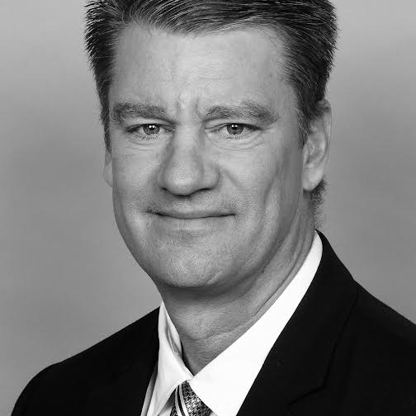
Inducted for Outstanding Contributions as an Individual of Central dewitt High School

Slide 3
Biography
1986 graduate and basketball standout Alyn Thomsen became Central DeWitt’s first student-athlete to receive a Division 1 scholarship. He earned 1st Team All-Conference honors and Honorable Mention All-Eastern Iowa as a Junior and as a Senior led the team in scoring, FG%, FT%, rebounding, and blocked shots. He was named 1st Team All-Eastern Iowa, 5th Team All-State and nominated for the McDonald’s All-American game. He currently holds three top-ten program records for scoring & blocked shots. He was a 4-year Letterman and Captain for the Tulsa Golden Hurricane. Alyn signed a free-agent contract with the LaCrosse, WI Catbirds, winning the 1992 CBA Championship. He ended his career playing professionally in Portugal.

Slide 4
Article from the Observer
Alyn Thomsen took center stage often during his career at Central DeWitt both on the basketball court and on the literal stage.
Thomsen is known for his seven-foot frame that helped him excel in basketball, but also his singing voice and poise on the stage while participating in both chorus and the chamber singers as well as school plays. The tall 1986 graduate was an imposing figure on the basketball court, first playing on the Sabers’ varsity squad as sophomore for fellow hall of famer, coach Neil Padgett.
During Thomsen’s sophomore season, he helped the Sabers to a 13-7 record, and the squad narrowly missed the state tournament. The next year, the Sabers went 15-6, finishing third in the Big Bend Conference. During that season, Thomsen earned first-team all-conference and honorable mention on the All-Eastern Iowa team. Thomsen was second in scoring and rebounds on the Sabers and was tops in blocked shots.
In 1986, Thomsen’s senior year, the Central DeWitt boys basketball team included two other tall players — the 6-foot-5 Mark Ahlers and fellow hall of famer, six-foot-nine Brig Tubbs — in addition to Thomsen. That team posted a 16-4 record and set a school record for the most wins in a row (13).

Slide 5
The Observer (cont.)
Thomsen led the team in field goal percentage, free throw percentage, rebounding and blocked shots. All that, combined with a team-leading 18.7 points per game, propelled Thomsen to First Team All Eastern Iowa recognition and Fifth Team All-State, INA honorable mention, and a nomination for the McDonald’s All -American Game. Thomsen ended his basketball career in the program’s top-ten rankings for points scored and blocked shots in a season and game.
Throughout his youth, Thomsen was also involved in little league baseball, 4-H, Scouts, cross country as well as the aforementioned chorus and chamber choir. Thomsen once participated in a play, “The Fifth Season’s Moon,” that was written by Central DeWitt classmate and hall of fame member Jonathan Price.
He was an honor roll student who graduated with honors. Thomsen attended the University of Tulsa after becoming the first Saber to receive a Division I athletic scholarship. He played in 109 basketball games for the Golden Hurricane as a four-year letterman. He was a captain his senior year and sits 10th all-time in blocked shots for Tulsa.
After graduating with a degree in economics, Thomsen became the first basketball player from DeWitt to play basketball professionally after signing

Slide 6
The Observer (cont.)
a contract with the LaCrosse (WI) Catbirds. There, he played for future NBA coach Flip Saunders and won the 1992 Continental Basketball Association championship. He played overseas and ended his career on the hardwood in Portugal.
Back state-side, Thomsen has worked in the pharmaceutical and medical device industry for the past 18 years and is currently the medical education manager of Titan Surgical Group in Lenexa, Kansas.
Thomsen lives in Kansas with his wife, Jeanne, and their two children, Sloan, 19, who is a pitcher at Johnson County, and Sawyer, 13, an avid volleyball player.

Slide 7
Induction speech
Inducted for Outstanding Contributions as an Individual
1986 graduate Alyn Thomsen would receive an offer from the University of Tulsa to play basketball and become Central DeWitt’s first student-athlete to receive a Division 1 scholarship. That would set a standard that many future Sabers have continued to pursue. Growing up in our community, Alyn was active in many activities such as Little League Baseball, 4-H and Scouting. In school, he was a member of the Cross Country team, Chorus and Chamber Singers. He participated in school plays, one of which was “The Fifth Season’s Moon”, a play written by fellow senior and 2008 Hall of Famer Jonathan Price. He was an Honor Roll student, graduating with Honors and represented the Eugene McManus Post at the 1985 American Legion Boys State. In basketball, Alyn’s 7 foot stature made him an intimidating figure. He played for Hall of Fame coach Neil Padgett, who elevated him as a Sophomore to the Varsity during a time when the high school was 10th-12th grades. They went 13-7 and beat 2nd ranked Maquoketa, just missing a chance to go to State, losing in the District finals. As a Junior, the team went 15-6, finishing 3rd in the Big Bend and holding opponents to 44-Points/Game. Alyn earned 1st Team All-Conference honors and Honorable Mention All-Eastern Iowa. Alyn was 2nd in Scoring and Rebounds and led the team with 102 Blocked Shots. The Sabers would participate as Independents in 1985-86 with Conference disbanding. Playing alongside 6’5” Mark Ahlers and University of Iowa recruit and 2013 Hall of Famer, 6’9” Brig Tubbs that team would go 16-4 and set a school record for most wins in a row (13). Alyn led the team in

Slide 8
Speech (cont.) & video
scoring, FG%, FT%, rebounding and blocked shots. He averaged 18.7 Points/Game. He was named 1st Team All-Eastern Iowa, 5th Team All-State by the Des Moines Register and INA Honorable Mention while being nominated for the McDonald’s All-American game. He currently holds top-ten program records for scoring (648), blocked shots in a Season (3rd - 106) and in a game (2nd - 11). He was a 4-year Letterman for the Tulsa Golden Hurricane, playing in 109 games and starting 30. He was a Captain his senior year. He is currently ranked 10th in career blocked shots. He graduated with a Bachelor of Science degree in Economics in 1991 and became the first basketball player from Central DeWitt to play a sport professionally. Alyn signed a free-agent contract with the LaCrosse, WI Catbirds of the Continental Basketball Association. There, he played for future NBA Head Coach Flip Saunders and they won the 1992 CBA Championship together. Flip helped transform “Big Al” with potential, into a successful professional, playing in the CBA and overseas. He ended his career playing professionally in Portugal. Alyn has worked in pharmaceutical and medical device sales for the last 18 years. He is currently the Medical Education Manager of Titan Surgical Group in Lenexa, KS. Titan is an Arthrex agency that covers the western half of Missouri and all of Kansas. Alyn is married to Jeanne. They have 2 kids. Sloan who played college baseball and Sawyer who will attend The University of California-Berkley to play volleyball. Please help me welcome the newest member of the Central DeWitt High School Hall of Fame, 2022 inductee… Alyn Thomsen.

