Slide 1
Ann Soenksen
Central Dewitt Hall of Fame
Induction Class 2022

Slide 2
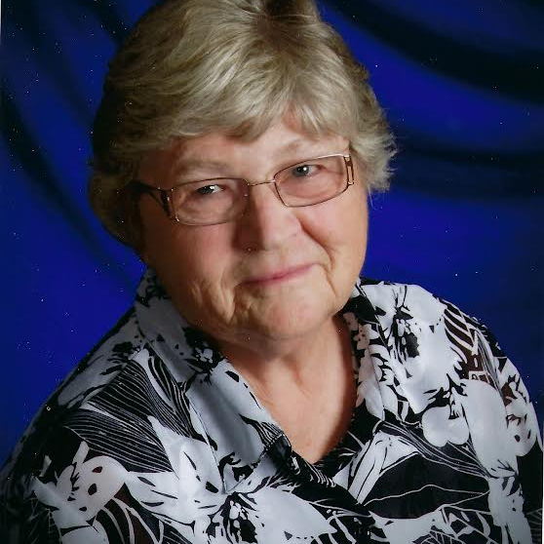
Inducted for Outstanding Contributions as a Friend of Central dewitt High School

Slide 3
Biography
Ann Soenksen, has been an invaluable resource for the past 20 years through the Historical Society in helping our Hall of Fame’s mission of honoring our past. On March 8, 1977, the Central Community Historical Society was officially established with a goal of creating a centrally-located historical society that would serve all communities in our county. Ann was appointed President and has served in that position for the past 45 years, providing the leadership for the advancement of the Central Community Historical Society. She conducts historical tours for school classes and has gone to great lengths to promote community pride, spirit and the historical awareness in DeWitt and surrounding areas while promoting tourism in Eastern Iowa.

Slide 4
Article from the Observer
It never dawned on Ann Soenksen she might one day be inducted into Central DeWitt High School’s Hall of Fame for one very simple reason — it isn’t her alma mater. Soenksen graduated from Calamus High School in 1958. So, when Central DeWitt Activities Director Jered Birt called her with the news, she was shocked.
“Honestly, I didn’t know what to say,” Soenksen said with a smile. As flabbergasted as she was, Soenksen still is letting the news sink in that she is being inducted for her “Outstanding Contributions as a Friend of Central DeWitt High School.”
To those who know Soenksen — the president of the board of directors for the Central Community Historical Society as well as the Clinton County Pioneer Cemetery Association — the fact she is being immortalized for her tireless work in preserving local history comes as no surprise.
That includes Sandy Miller, a dedicated volunteer at Central Community Historical Society and Museum, in DeWitt. “Ann is the lifeblood of this place,” Miller shared, as she stood among the countless displays of artifacts the museum has collected over the years. “If somebody wants to know something, it’s all in her head. She’s spent her life here, and it shows. We

Slide 5
The Observer (cont.)
have a pretty wonderful museum. It’s amazing how many people have donated items here and how much has been accumulated. Even people who live here in town and go by this place every day, they’re just amazed when they come in and see.”
When Miller said the museum has been Soenksen’s life’s work, she meant it. For 45 years — since 1977 — Soenksen has been president of the Central Community Historical Society. It was an endeavor that she started with Marv Doescher, who wanted to start a historical society in the DeWitt area. “There was a meeting at his house the first week of December in 1976,” Soenksen recalled. “About 12-14 of us showed up. Another meeting was held the first part of January, not as many came back. But I did.”
Soenksen said she’d always loved history in school and had been conducting genealogy since the 1960s. She, Doescher and some other volunteers met a couple of more times, got their articles of incorporation together and registered with the state in March 1977. For the next several years, they had fundraisers and collected donations. Then, in June 1983, Doescher died suddenly of a heart attack. “We had done a lot of things, and accumulated a lot of things by that time,” Soenksen related. “The plan was to eventually get a small building and have a museum. (Doescher) was gone, but we wenton.” Together with her board members, Soenksen kept the dream

Slide 6
The Observer (cont.)
alive and in 1987, they acquired the building — a former gas station and repair place — located at 628 Sixth Ave., in DeWitt. “I remember at the time thinking, this is so big!” she said with a grin. “I said, ‘We’ll never get this full.’”
Since then, Soenksen and her volunteers transformed that dirty garage into an impressive space containing both permanent and rotating displays that capture Clinton County history. The museum also has genealogical research materials, dating back from 1868 to the present, obituary and cemetery records, marriage and birth records, family histories and more.
The museum also has expanded to include three more buildings. Soenksen said she and her volunteers get calls from all over the country — and even the world — to assist people inquiring about local history. For Soenksen, the best part is the genealogy. “I’ve always loved doing that,” she said. “With all of these artifacts, you have people involved. You need the history of the people … that’s where the genealogy comes in.” She credits the devotion of her volunteers in making the museum and everything it entails possible. She also is grateful to two families in particular whose financial contributions are the reason the museum still exists — Fred and Mary Maltas and John and Wilma Andersen.

Slide 7
The Observer (cont.)
While Soenksen and her volunteers never have been paid for their services, bills for things such as utilities still need to be paid. Thanks to their generous donations, the museum is what it is today.
As the keeper of Clinton County’s history, Soenksen said she would like to think that one day, someone will be willing to take her place and continue what she started.
“I just hope after I’m not able to do this, it keeps going,” Soenksen shared. “After 45 years of my life, I’m proud of what this has turned out to be. There are so many treasurers here. It’s unbelievable.”

Slide 8
Induction speech
Inducted for Outstanding Contributions as a Friend
Our Hall of Fame constitution states that “The Central DeWitt High School Hall of Fame is established to create a lasting tribute to those who have brought honor to themselves, their school, and our communities,” and the category of “Friend” was added for “Persons who have made outstanding contributions to Central DeWitt High School, generally over a long period of years.” These are fitting descriptions of Ann Soenksen, who has been an invaluable resource for the past 20 years through the Historical Society in helping us reach our mission of honoring our past. For every ceremony, much of the information that is gleaned for the purpose of inductions have been archived and made accessible through her efforts. Ann did not grow up in our community but has become a fixture in it, working tirelessly over the past 45 years to develop, maintain and turn the Central Community Historical Society and Museum into something special. In 1976, Marvin Doescher suggested there could be interest in the development of a Historical Society. After working on the Bi-Centennial committee, Ann responded to ad seeking anyone who might have that interest, and as the saying goes… the rest was “history”! On March 8, 1977, the Central Community Historical Society was officially established with a goal of creating a centrally-located historical society that would serve all communities in our county. With a newly organized Board of Directors and articles of incorporation, they appointed Ann as President who has now served in that position for the past 45 years. In 1987, she

Slide 9
Speech (cont.) & video
directed the purchase of a gas station at the corner of 7th Street & 6th Avenue for $50,000 from donations, dues and a $25,000 commitment from the DeWitt City Council. By 2002 there were over 100 paid members, 4 officers and 5 Board Members in addition to countless volunteers who are the lifeblood of their mission. Not only has Ann provided the leadership for the advancement of the Central Community Historical Society, she has also helped in fund-raising efforts, donor contributions and organized the resources and plans for maintenance and expansion of the building site. Today the Historical Society is housed in 3 buildings. During her time as President, they have sponsored an annual Old-Fashioned Day, registered buildings as historic sites and created publications of historical calendars. She conducts historical tours for school classes and has gone to great lengths to promote community pride, spirit and the historical awareness in DeWitt and surrounding areas while promoting tourism in Eastern Iowa and expanding exposure through Facebook and Twitter. Ann once stated, “If we don’t save it, we won’t have it.” The non-profit organization is still expanding and collecting items under her leadership and will be a valuable asset for generations to come. Ann has also served as an election day worker for the past 30 years, Chair of the Clinton County Pioneer Cemetery Commission, Board Member of the Lincolnway Foundation and Secretary of the Clinton County Preservation Commission. She has been recognized for her contributions to our community over the years in other ways as well, once serving as the Grand Marshall for the 4th of July Parade and receiving the 2nd ever Spirit Award. She and husband Floyd have 5

Slide 10
Speech (cont.) & video
children and have farmed east of DeWitt. Please help me welcome the newest member of the Central DeWitt High School Hall of Fame, 2022 inductee… Ann Soenksen.

