Slide 1
Dr. donna helble
Central Dewitt Hall of Fame
Induction Class 2020

Slide 2
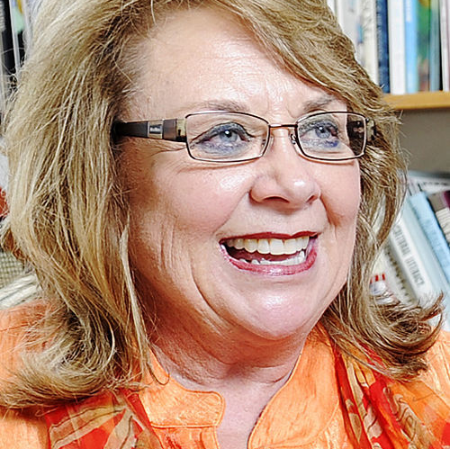
Inducted for Outstanding Contributions as a distinguished graduate of Central dewitt High School

Slide 3
Biography
1967 graduate, Donna Helble was a leader in Education. She served as an Elementary Teacher for 15 years and earned her Doctorate in Language Arts Education. She was a Professor of Education at Winona State University for 24 years and chaired the “Reading on the Mall” event, advocating children’s literacy. She was a Rotary Club member and chaired many enrichment programs for elementary students and was a co-founder of the “International Reading Association”. She earned many awards for her immense professional contributions including the Rotary International Distinguished Club President. Winona State recently recognized her by renaming Wabasha Hall, the centerpiece of their education village the Dr. Donna J. Helble Hall.

Slide 4
Article from the Observer
Dr. Donna Helble, a 1967 graduate of Central DeWitt High School, loved to learn as much as she loved to teach. The only child of the late Donald and Helen Helble, of DeWitt, passed away from complications from an illness in March of 2017, yet she left behind an amazing legacy of being an incredible leader in education.
While in high school, Helble immersed herself in as many activities as she could. She participated in band, chorus and was part of the school musical, “The Music Man.” She was a school leader and member of the National Honor Society, student council for four years and was a senior class officer. Helble also was on staff of the school newspaper, the Saber Salute, and the Librarian Club, French Club, Science Club, Future Teachers of America and the AFS, a club affiliated with the international foreign exchange program.
After graduation, she attended Simpson College, where she earned her bachelor’s degree in elementary education and French. Helble went on to earn her master’s degree in remedial reading from Winona State University and a doctorate in language arts education from Northern Colorado. Friends say her greatest passions were education and literature. In 1973, she followed in her mother’s footsteps and began a teaching career at Goodview Elementary School, where she taught grades one through four in the Program for Learning in Accordance With Needs.
It was in 1988, when Helble began teaching at the university level — Winona State University, in fact, as a professor of education. She was adjunct professor at St. Mary’s University of Minnesota and the University of

Slide 5
The Observer (cont.)
Northern Colorado. She also completed an internship for the Hon. Tim Penny, U.S. Congress, First District Minnesota. At WSU, Helble chaired a community-wide “Reading on the Mall” event for 25 years. It was a popular event, which promoted literacy in Winona and surrounding communities. The day-long event drew more than 2,000 people a year, and each child in attendance was given a new book to take home.
Helble also was a member of the Rotary Club and for 26 years was the chairperson of the Rotary Readers program. She also worked for Books for Babies, another club project, that provided nurses with books to present to new parents in order to encourage them to read to their children. Also through rotary club, Helble chaired the Shadow Program for more than 28 years, which matched high school students with Rotarians or community members in a profession in which they took an interest. Helble designed the model for the “Maxwell Math Club,” an after-school enrichment program for elementary students held on the WSU campus. She also was co-founder of the Student International Reading Association on campus.
In her community, Helble also shared her generous spirit by serving as president or a board member of Big Brothers/Big Sisters of Winona, Winona Rotary Club, United Way of the Greater Winona Area, Winona County Unite of the American Red Cross, the Winona County Cancer Society, the Winona Friends of the Library, the Winona Community Foundation and the Winona branch of the American Association of University Women. For the multitude of these and other involvements, Helble earned many distinctions. She was

Slide 6
The Observer (cont.)
Winona Teacher of the Year, inclusion in the Who’s Who Among American Teachers, the Thomas Stark Award from United Way, the Celebrate Literacy Award from the International Reading Association, the Athena Award for women in leadership from the Winona Chamber of Commerce, the Ben and Adith Miller Tribute from Winona Health, Rotary International Distinguished Club President (which was awarded in Barcelona, Spain), a certificate of appreciation from the city of Winona for increasing literacy among community youth and a certificate from the Minnesota Senate for promoting literacy. Her name also was included in Who’s Who of American Women, the International Who’s Who of Professional Business Women and Outstanding Young Women of America.
In July of 2018, after her death, WSU named a building in its education department after Helble. As much as she loved traveling all over the world, DeWitt always held a special place in Helble’s heart. Helble’s obituary said she always will be remembered by those close to her, not just for her many achievements, contributions and leadership, but for her energy, wit and loving and giving spirit.

Slide 7
Induction speech
Inducted for Outstanding Contributions as a Distinguished Graduate
For several years there has been a great deal of support to induct 1967 graduate, Donna Helble, into our Hall of Fame. Tonight, that is realized by honoring this tremendous educational leader. In high school, Donna participated in band, chorus and was part of the school musical, “The Music Man”. She was a school leader and member of the National Honor Society, Student Council for 4 years and a senior Class Officer. She was on the Saber Salute staff, our school newspaper and very active in clubs such as the Librarian Club, French Club, Science Club, Future Teachers of America and the AFS, a club affiliated with International Foreign Exchange. Following graduation, Donna enrolled at Simpson College and received her Bachelor’s degree in Elementary Education and French. She earned a Master’s degree in Remedial Reading from Winona State University and a Doctorate in Language Arts Education from Northern Colorado. She began her teaching career at Minnesota City Elementary School in 1973 and continued at that level for the next 15 years. She was once named the Winona Teacher of the Year. In 1988 she began a 24-year career as a Professor of Education at Winona State University and Adjunct Professor at Saint Mary’s University of Minnesota and the University of Northern Colorado. She served as Teacher Intern for the Honorary Tim Penny of the Minnesota U.S. Congress. During her career Dr. Helble chaired the popular “Reading on the Mall” event for 25 years, advocating for children’s literacy in communities. She was a Rotary Club member for 26 years and chaired their “Rotary Readers

Slide 8
Speech (cont.) & video
Program”, which sent Rotarians into elementary classrooms to donate books and read to children. She was also involved with “Books for Babes” an initiative to encourage young parents to read to their children, and chaired the “Shadow Program”, which linked Rotarians to high school students with professional interests. She designed the model for the “Maxewell Math Club” an after-school enrichment program for elementary students and was a co-founder of the “International Reading Association” at W.S.U. She also served as President or Board Member of 10 other community and university organizations and was an officer in 7 others. For her incredible professional contributions and servant leadership she earned many awards and recognitions throughout her life of a champion. Awards from the United Way, International Reading Association, Winona Chamber of Commerce, Winona Health, City of Winona, Minnesota Senate, Who’s Who of Professional Business Women, Outstanding Young Women of America and the Rotary International Distinguished Club President Award in Barcelona, Spain. Recently Winona State University announced that their $34 million Wabasha Hall, the centerpiece of their education village, would be renamed the Dr. Donna J. Helble Hall. She was an avid bridge player and traveled all over the world. She was energetic, witty, loving and had a giving spirit to people both local and throughout the world. She loved learning and educating children. She passed away in 2017. Please help me welcome posthumously, the newest member of the Central DeWitt High School Hall of Fame, 2020 inductee… Dr. Donna Helble.

