Slide 1
Erin schlotfeldt
Central Dewitt Hall of Fame
Induction Class 2021

Slide 2
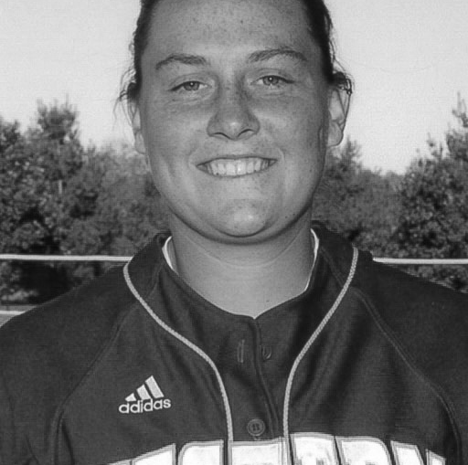
Inducted for Outstanding Contributions as an Individual of Central dewitt High School

Slide 3
Biography
2006 graduate Erin Schlotfeldt earned 16 Varsity Letters as a Saber. She was an All-State Volleyball player and 3rd Team INA All-State Basketball player holding 2 top 10 program records. She was 4X 1st Team All-WaMaC and 4X All-State Softball player helping the 2005 team finish 5th at State. She held program records for Career Homeruns (17), Homeruns in a Season (11), 2nd for Total Bases (335), Games (232) Doubles (50) and 3rd in At Bats (685), RBIs (149) and Hits (228). At Western Illinois she was a 3X All-Summit League and 4X Academic All-League Softball player. She led the league in Batting Avg. (.400), Slugging Percentage (.713), and Total Bases (82) and named to the 2011 Capital One/CoSIDA Academic All-District Softball Team.

Slide 4
Article from the Observer
Erin Schlotfeldt participated — and excelled — in a number of sports during her time at Central DeWitt High School. She earned a number of honors, almost too many to count, and is considered one of the school’s most decorated athletes of all time.
However, being inducted into Central DeWitt’s Hall of Fame was not an idea that ever crossed her mind. “I was super surprised,” Schlotfeldt said of learning she is being honored for “Outstanding Contributions as an Individual of Central DeWitt High School.” “It’s not really something you think about … it feels like it was forever ago when I was in high school. But this is such an honor. It’s the highest honor the school can give a graduate … it’s gratifying even to be nominated.”
During her time in high school, Schlotfeldt earned 16 varsity letters in five sports (softball, 5; basketball, 4; volleyball, 3; soccer, 2; and track, 2). The daughter of Ed and Peggy Schlotfeldt, of DeWitt, is one of just two Saber athletes to earn All-Conference honors in four sports, and to earn first-team All-Conference honors in three sports.
Beginning with eighth-grade softball, she was a second-team All-Conference catcher and earned All-State honorable mention. Her freshman year, in 2003, Schlotfeldt earned All-Conference honorable mention accolades in basketball and was first-team all-conference as a utility player for softball.

Slide 5
The Observer (cont.)
Her sophomore year, Schlotfeldt was second-team all-conference in basketball and first-team all-conference as a utility player and third-team all-state in softball. In 2005, as a junior, Schlotfeldt received all-conference honorable mention in volleyball; first-team all-conference, all-district and INA third-team all-state in basketball; all-conference honorable mention in soccer; and first-team all-conference as a catcher, second-team all-state, all-district and helped lead the team to the school’s first appearance at state (where they placed fifth) in softball.
Her senior year, she was first-team all-conference and an all-state honorable mention in volleyball; and was first-team all-conference as a utility player and third-team all-state in softball. In basketball her senior year, Schlotfeldt only played nine games due to a torn ACL. In softball, she only played the second half of the season after coming back from the injury. Schlotfeldt also made then-Observer sports editor Steve Thiltgen’s all-decade basketball team; ended her basketball career ranked fifth at Central DeWitt in career rebounds (358) and 10th in scoring (549); in 2004 she broke the school record for career home runs (17) and home runs in a season (11); ended her softball career second in total bases (335), games (232) and doubles (50), and third in at-bats (685), RBIs (149) and hits (228). She also was the second Central DeWitt athlete to earn first all-conference in volleyball, basketball and softball, and the second athlete to earn all-conference honors in four sports.

Slide 6
The Observer (cont.)
After graduation, Schlotfeldt went on to continue a highly successful athletic and academic career at Western Illinois University. There, she played softball and graduated Cum Laude with a bachelor’s of science in Kinesiology (physical education). Then, she received her master of education from Graceland University in the spring of 2016.
Schlotfeldt credits her coaches, including Greg Weller and Pat Meade, and teachers, including George Pickup, for pushing her to give her best and to be successful. “Mr. Pickup is someone I’ve always looked up to,” Schlotfeldt shared. “At that time, he coached the boys basketball team, and what he expected from his players … that extended to his classroom. “He had a sign in his room that had a quote that said, ‘Character is what you choose to do when nobody is watching.’ That’s something I live my life by now.”

Slide 7
Induction speech
Inducted for Outstanding Contributions as an Individual
2006 graduate Erin Schlotfeldt is one of the most decorated athletes in Saber history, earning 16 Varsity Letters in 5 sports (Softball 5/Basketball 4/Volleyball 3/Soccer 2/Track 2)! She was a leader, intense competitor and outstanding at whatever she did. She is one of two Saber athletes to earn All-Conference honors in 4 sports and to earn 1st Team All-Conference honors in 3 sports. She earned 2 Track Letters but as a junior, joined Soccer in their first season and was a team Captain and earned All-Conference recognition. In Volleyball she was also recognized as a Captain and selected All-Conference as a Junior and 1st Team All-WaMaC and Honorable Mention All-State as a Senior. She played Varsity Basketball as a freshman and selected All-Conference Honorable Mention, 2nd Team as a sophomore and as a junior earned 1st Team All-WaMaC, All-District and 3rd Team INA All-State on a team that won the WaMaC East title. She only played 9 games her senior year due to a torn ACL but ended her career 5th in Career Rebounds (358), 10th in Scoring (549) and was a member of The Observer’s All-Decade team. It was Softball where she made her mark as one of the greatest in program history. She was a five-year starter and middle-of-the-order bat for the best era of Saber softball winning 2 WaMaC East Titles and the only team in program history to play in the State Softball tournament. As an 8th grader, she was a 2nd team All-WaMaC catcher and All-State Honorable Mention. The next 4 seasons she was voted 1st Team All-WaMaC as a Utility player or Catcher.

Slide 8
Speech (cont.) & video
She was 3rd Team All-State as a sophomore and as a junior helped propel the team to their 5th place finish at State Softball, being selected to the All-District team and 2nd team All-State. Although she only played the second half of her senior season, she was recognized as 3rd team All-State. She ended her career with school records for Career Homeruns (17), Homeruns in a Season (11), 2nd in Total Bases (335), Games (232) and Doubles (50) and 3rd in At Bats (685), RBIs (149) and Hits (228). Erin earned a Softball scholarship to Western Illinois and experienced great success. She was a 2nd team All-Mid-Continent catcher as a freshman and Academic All-League as an injured redshirted sophomore. The following 3 seasons she was a 2X 1st team All-Summit League and 3X Academic All-League selection. As a senior, she led the league in Batting Avg. (.400), Slugging Percentage (.713), and Total Bases (82) and finished the season ranked 68th for NCAA Division 1 programs in Batting Avg. (.400) & 63rd in Slugging Percentage (.713) and named to the 2011 Capital One/ CoSIDA Academic All-District Softball Team, 2nd team District 5. She was voted team Captain in 2007 and 2009-2011 and a member of the Student Athlete Advisory Committee. Their teams were regular season Conference Champions in 2007, 2009, and 2010 and Conference Tournament Champions in 2008 earning a NCAA Regional birth. Erin graduated Cum Laude with a Bachelor of Science in Kinesiology and received her Master of Education in Special Education from Graceland University in 2016. She currently lives in Davenport with her girlfriend Megan, 2 dogs and a cat while teaching Special Education at Camanche High School and coaching

Slide 9
Speech (cont.) & video
Volleyball and previously varsity softball. Please help me welcome the newest member of the Central DeWitt High School Hall of Fame, 2021 inductee… Erin Schlotfeldt.

