Slide 1
Fletcher Paulsen
Central Dewitt Hall of Fame
Induction Class 2022

Slide 2
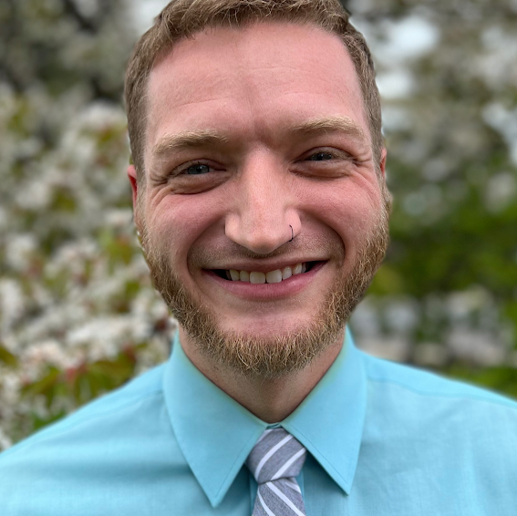
Inducted for Outstanding Contributions as an individual Central dewitt High School

Slide 3
Biography
Few people have set the bar higher than 2011 graduate Fletcher Paulsen. He was selected to the Student Council (President), NHS and was the Student Representative for the DeWitt Area Fine Arts Foundation. He was a member of the 2009 State Champion Track & Field team and managed the varsity volleyball team. He excelled in the fine arts and was selected 3X to the All-State Choir and was the 2010 IHSMA State Solo & Ensemble Outstanding Performer. He participated in Chamber Singers, Band, Jazz Band and the Marching Saber Pride serving as Drum Major. He earned two All-State Speech honors and the IHSAA State Individual Speech Outstanding Performer. He was the QC Times Salute to Academics & Achievement Humanities Award recipient.

Slide 4
Article from the Observer
When 2011 Central DeWitt High School graduate Fletcher Paulsen found out he was being inducted into his alma mater’s Hall of Fame this year, he couldn’t wait to share the news with his family. Paulsen, who lives in Racine, Wisconsin, where he works as the performing arts department chair and middle and upper school choir director at The Prairie School, tried calling his mom, Margo Fletcher, who lives in DeWitt, but she didn’t answer.
His next call went to his grandma, Joyce Fletcher, who also lives in DeWitt, and to Paulsen, it seemed fitting she would be the first one to hear the news. After all, Joyce was inducted into Central DeWitt’s Hall of Fame in 2006. “My primary thought was how excited I was to have another shared experience with my grandma,” Fletcher shared. “That was something that was a constant growing up. I witnessed my grandma’s induction, and I am flattered and humbled to be in the same group as her and so many others.”
As a student at Central DeWitt, Paulsen stayed busy participating in musicals and plays, speech, Chamber Singers, marching band (he served as drum major), jazz band, National Honor Society, student council (for which he served as president), the Best Buddies program, manager of the volleyball team, track (he was a member of the 2009 state champion track & field team) and was the announcer for softball games.

Slide 5
The Observer (cont.)
He also was a student representative for the DeWitt Area Fine Arts Foundation, was selected three times to the All-State Choir and was the 2010 IHSMA State Solo and Ensemble Outstanding Performer. He also earned two All-State Speech honors, was the IHSAA State Individual Speech Outstanding Performer and was the Quad City Times Salute to Academics and Achievement Humanities Award recipient.
After high school, Paulsen attended Carthage College in Kenosha, Wisconsin, where he majored in music and minored in secondary education. His love for music developed at an early age, Paulsen said. It was in sixth grade, specifically in Ms. Emily Speltz’s class, that he remembers wanting to be a teacher. However, it wasn’t until he was in high school and was a member of the All-State Honor Choir working with guest conductor, Dr. Edith Copely, from Northern Arizona University, that he set his sights on music education.
“The choir was made up of hundreds of high school students, and (Copely) had us in the palm of her hand for the hours-long rehearsals,” Paulsen recalled. “Rehearsals were full of laughter and fun, and we sang some amazing music together. My time in All-State opened my eyes to so much the choral world has to offer, and my love continued to grow in choir and school and future All-State events.

Slide 6
The Observer (cont.)
“Mrs. Jeannie Dean capitalized on the high number of music students in and around our grade and pushed us to sing the music of the same caliber as All-State,” Paulsen said. “My inspiration to teach choir comes from those memories in high school and all the hours we spent together working out the Chamber Singers’ Christmas show, rehearsing for musicals and learning music.” Paulsen cited Carolyn Eggleston as another inspiration. She taught him private voice lessons throughout high school, and, as he put it, “her legacy speaks for itself.”
Achievements he has made so far in his career include winning a Jerry Award (Wisconsin Theatre Awards Show) for outstanding musical direction for last year’s production of “Chicago.” Otherwise, Paulsen gives all the credit for his professional success to his students. “At Prairie, I get to work with students every day and make music,” he related. “So, my biggest accomplishment is that I get to do what I love.”
Josh Greubel, Director of high school bands at Central DeWitt, instructed Paulsen all four years of high school and described him as a “leader in everything he did.” One of the criteria for a past student to be inducted into the Central DeWitt Hall of Fame, is that he or she must be graduated for at least 10 years.

Slide 7
The Observer (cont.)
Greubel said he simply had been waiting for the appropriate amount of time to lapse for Paulsen to installed. “He’s belonged in the Hall of Fame for a long time,” Greubel related. “He’s a shoe-in. He’s a fantastic musician, a fantastic student … I’m so thankful he was part of my program. He made it better. He’s a great kid.”
Paulsen described his list of people to thank for their support over the years as “vast,” and includes many teachers at Central DeWitt. His family, he said, definitely tops the list.
“They supported me from the start by acknowledging my love for music and signing me up for piano lessons,” he shared. “My grandma and I performed together countless times, and she is my biggest inspiration I have had throughout my life. My parents … my sister … in every school community I have been a part of, support for the performing arts has been top-notch and I feel incredibly grateful to have felt such constant love and support.”

Slide 8
Induction speech
Inducted for Outstanding Contributions as an Individual
Few people have set the bar higher in their specific activities during their time in school, more than 2011 graduate Fletcher Paulsen. He was heavily involved in the performing arts and took advantage of every opportunity that came his way. Fletcher was an outstanding student and leader. He was selected all four years as a member of the Student Council, and served as President his senior year. He was elected to the NHS and participated in the 2010 American Legion Boys State, learning about city, county and state government. He served as the Vice President & President for GO4IT, the philanthropic organization serving non-profits in Clinton County and volunteered for Best Buddies. He was the student representative for the DeWitt Area Fine Arts Foundation. Fletcher was selected to the Homecoming Court as a Freshman and was a member of the JS Titan Academic team. He was a hurdler on the 2009 State Champion Track & Field team and spent all four years as a manager for the varsity volleyball team, he was the announcer for softball games from 6-12th grade and was active in 4-H and ACT (Active Christian Teens). It was his involvement in Fine Arts activities where he really set that bar so high. Over his time in school, he earned numerous Division 1 State Ratings including five in 2009. During his four years of Choir, he was selected three times to the All-State Choir and in 2010, was selected as the IHSMA State Solo & Ensemble Outstanding Performer. He also participated in

Slide 9
Speech (cont.) & video
Chamber Singers. Fletcher played in the Band and the Marching Saber Pride during his four years in school. He served as the Drum Major as a senior. During that time, the Marching Band earned its first Division 1 Rating in 17-years and also performed at the 2010 Orange Bowl Parade and Orange Bowl opening for the Goo Goo Dolls. He played the trumpet in the Jazz Band, which also earned a Division 1 rating in 2009. Outside of the school day, he was very active in the plays, musicals and speech. He twice earned All-State honors in Speech and was named the IHSAA State Individual Speech Outstanding Performer his senior year. He was selected as the lead in the play “Our Town” and was part of every musical, play or variety show that was produced including “Bye Bye Birdie”, “Into the Woods”,” Sight Unseen” and “Oklahoma”. He volunteered as pianist at his church and also volunteered as a MS Accompanist. Fletcher was our QC Times Salute to Academics & Achievement Humanities Award recipient and at the Senior Awards Day, earned the Quincy Jones Musicianship Award, Outstanding Choral, Speech & Drama Awards. Upon graduation, he attended Carthage College in Kenosha, Wisconsin to study Vocal Music Education. His involvement in Carthage Choir gave him opportunities to tour Ireland, Scotland, and Spain, and included a Midwest tour which culminated in a performance right here in our own Performing Arts Center. He graduated in 2015 and began working as the Choir Director at The Prairie School in Racine, Wisconsin last fall. He currently serves as the Performing Arts Department Chair, and directs the choirs and

Slide 10
Speech (cont.) & video
musicals. He is an Assistant Varsity Volleyball Coach for the Hawks. He continues to volunteer as an area Director at Camp Heart Connection, a program in which his family has been involved since 1995. Please help me welcome the newest member of the Central DeWitt High School Hall of Fame, 2022 inductee… Fletcher Paulsen.

