Slide 1
JEN KEITEL
Central Dewitt Hall of Fame
Induction Class 2023

Slide 2
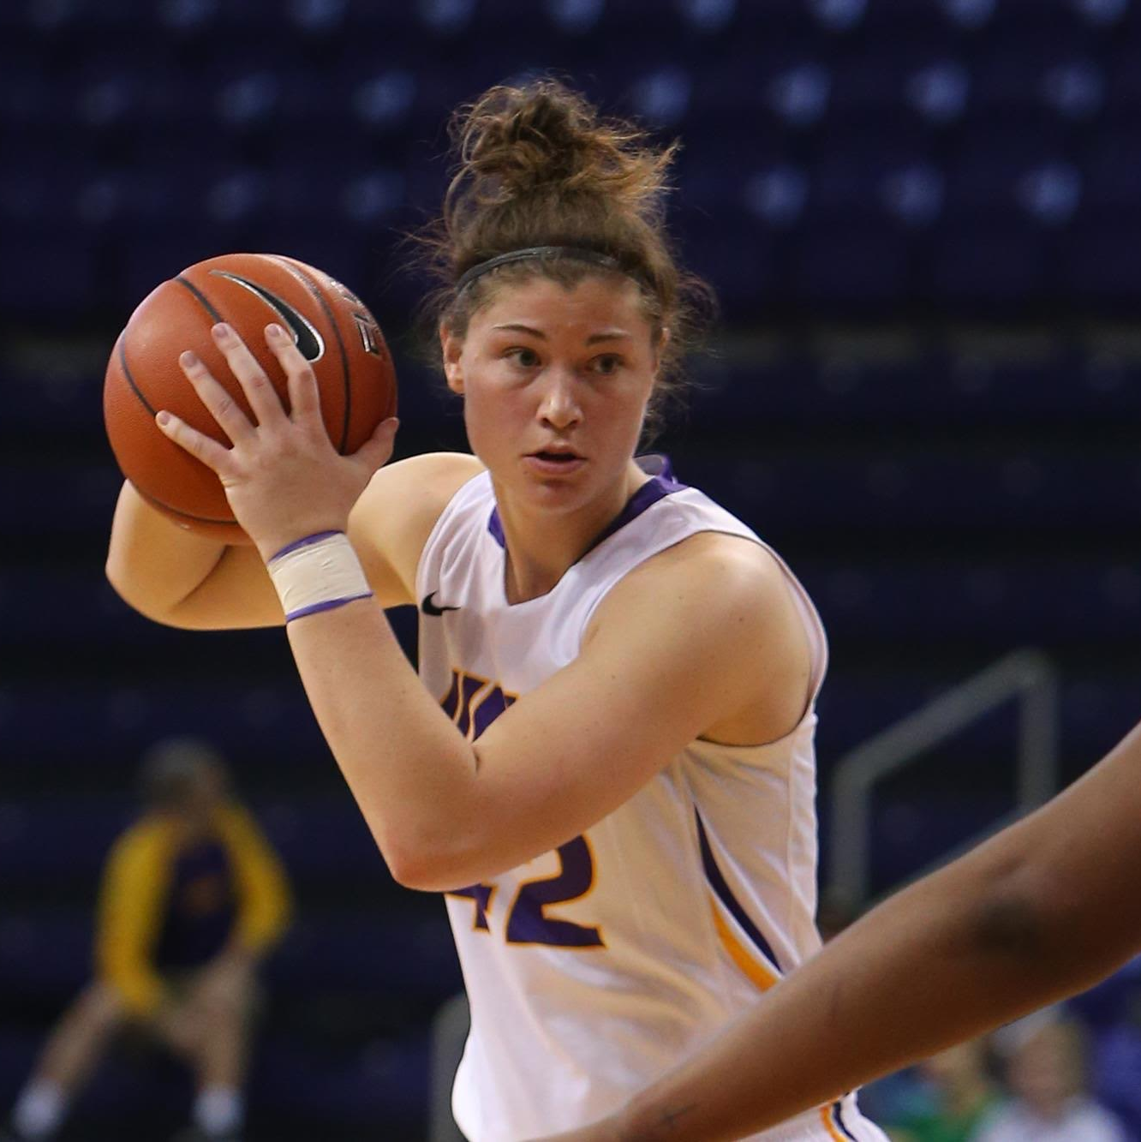
Inducted for Outstanding Contributions as an INDIVIDUAL of Central dewitt High School

Slide 3
Biography
2011 graduate Jen Keitel was as dominant multi-sport athlete who played Basketball, Softball, Track & Field, Cross country, and Soccer. She Qualified for the State tournament in the Discus and was a Softball 4-year Varsity starter. In Basketball, Jen scored 1,258 points and recorded 688 rebounds in her career. She was selected to the INA, IGCA and Des Moines Register Class 1st Team All-State. She helped her team earn 2 WaMaC and District titles and a 2011 trip to the 3A Semifinals. She played basketball at the UNI and started 92 of 106 games, helping her team win a MVC Conference Championship and appearance in the WNIT. She earned First Team & Honorable Mention All-MVC recognition and All-MVC Scholar Athlete honors in 2013 & 2016.

Slide 4
Article from the Observer
Hampered by a late hiring and an inexperienced roster, the first Central DeWitt girls basketball team under head coach Mark Kurtz won a single game. The Sabers, however, entered the 2007- 08 campaign with a sense of optimism. Not only did they have a season — and just as important — an offseason working with Kurtz, but help was on the way. Joining the varsity program that winter was a talented freshman class led by 2023 Central DeWitt Hall of Fame inductees, Lindsay (Smith) Knake and Jen Keitel. What the Sabers accomplished over the next four years more than likely exceeded that optimism. During Knake and Keitel’s time in purple and gold, Central DeWitt went 81- 17, won a pair of WaMaC East crowns and ultimately advanced to the 2011 3A state semifinals.
The duo’s presence had an immediate impact: Knake and Keitel combined for 34 points in their very first varsity contest and before December had even started, the Sabers had more victories (four) than they did the year prior. “With their talent and skill level there is question they belong at the varsity level,” Kurtz said. “I think our first four games proved that.” Central DeWitt ended up winning 17 games in 2007-08 before bowing out to the reigning 3A state champion. Knake was the team’s leading scorer, dropping in 14.3 points per game, while also coming up with a team-high 54 steals, 43 assists and 106 rebounds. Her play earned her a first-team spot on the All WaMaC East squad — the first East player to be named to the first team since the conference was rearranged in 2003-04 — and the Saber was one of

Slide 5
The Observer (cont.)
just three freshmen across Iowa to be named to the Iowa Newspapers Association (INA) all-state team, where she was a third-team pick in 3A. Keitel added 211 points of her own and paced the Sabers in both rebounds (131) and blocked shots (26), while also coming up with 25 steals. She was just the second WaMaC East freshman to be named to the All-WaMaC East second team since 2003- 04.
Central DeWitt was even better in 2008-09, going 19-4, including a perfect 14-0 mark in the WaMaC East. This time, both Knake and Keitel earned first-team All-WaMaC East honors, a feat they would repeat again as juniors and seniors. They combined for over 60 percent of the team’s scoring and spearheaded a defense that held 19 different foes under 40 points, highlighted by a 37-30 3A regional victory over MAC champion Davenport Assumption, the reigning 2A state champion. Knake earned first-team all-state honors after a campaign in which she averaged 15.6 points per game, dished out 128 assists, grabbed 105 rebounds and collected 62 steals. Keitel added 12.2 points per game, again led the Sabers with 164 rebounds and 47 blocks. She impressed Kurtz by dishing out 53 assists of her own, while also coming up with 44 steals.
The Sabers repeated as WaMaC East champions in 2009-10, going 13-1 — Central DeWitt avenged the lone loss to Mount Vernon, handing the eventual

Slide 6
The Observer (cont.)
2A state champions its final setback of the winter — part of a 21-4 mark overall.
Both Knake and Keitel were honored with INA all-state honors, the former on the first team, the latter on the third. Just a single point separated the duo with Keitel pouring in 370 and Knake 369 (both averaged 14.8 points per game). Keitel pulled down a personal-best 195 rebounds (7.8 per game) and had 46 assists, 44 steals and 32 blocks. Knake added 182 rebounds of her own and had 153 assists and 76 steals — all personal- bests.
Central DeWitt advanced to the regional finals — one game away from state — but fell to eventual 3A runner-up Waukon. That provided extra motivation for Keitel and Knake’s final prep season. The Sabers responded, winning 24 games in 2010-11. The campaign featured impressive regular season victories over 3A No. 2 Mount Vernon and 4A No. 5 Cedar Rapids Washington — the latter victory coming as part of Rivalry Saturday at the U.S. Cellular Center in Cedar Rapids — and 12 more WaMaC East victories.
Most importantly, the season ended in Des Moines as the Sabers dispatched Maquoketa, Dubuque Wahlert and finally Decorah in the regional tournament to punch the program’s first state tournament ticket since 1995. The Sabers’

Slide 7
The Observer (cont.)
quarterfinal game with MOC-Floyd Valley proved to be bittersweet as Central DeWitt handed the Lady Dutch their very first loss of the season — Keitel had a double-double with 17 points and 15 rebounds — but did so only after losing Knake to a significant knee injury. Playing without one of their star seniors, the Sabers battled Mount Vernon in 3A semifinals, holding the Mustangs 15 points under their scoring average, but were limited to 29 themselves in a 41-29 setback.
Keitel accounted for nearly half of the points with 13 and added six rebounds, two assists and two blocks, while being named to the all-tournament team. Ultimately, both Keitel and Knake were selected to the INA 3A all-state first team after a season in which the pair outscored 96 teams in the state with their 807 combined points.
Knake led the Sabers with 410 points (an average of 15.8 per game), while grabbing 159 rebounds, dishing out 131 assists and coming up with 82 steals. All told, Knake poured in 1,467 career points, which still sits as the most among Central DeWitt and Observer-area girls basketball players. Her 455 career assists, meanwhile, are also a school record, while her 274 steals are second for a career. “I think Lindsay is one of the best all- around players that the conference has seen in some time,” Kurtz said during her senior campaign. “She is like a five-tool player in baseball because she can handle

Slide 8
The Observer (cont.)
the ball, she can defend, she can shoot, she can pass and she can rebound.” “She has had a tremendous four years with the team and she’s going to find her name in the record books for a long time.” Keitel added 397 points in her senior campaign with 198 rebounds, 92 assists, 59 steals and 39 blocked shots. Those totals gave her 1,258 points for her career, which currently ranks third in program history and sixth among all Observer-area girls players. Keitel’s 688 career rebounds remain a school record and the highest total for any area girls basketball player and her 144 blocked shots still ranks second in school history.
“Jennifer made it so difficult for teams because of her presence in the post and her ability to pass the ball,” Kurtz said after her senior year. “The improvement that [she] has made over the last four years was startling.” Basketball was not the only sport in which Knake and Keitel excelled while at Central DeWitt.
Both were state track qualifiers in 2010 with Keitel making it in the discus — she threw a season-best 109-2 and Knake qualifying in the maximum four events: the 400-meter hurdles and the shuttle hurdle, 4x200 and 4x400 relays. Knake ended up as a nine-time state track qualifier and her 2010 clocking of 1:05.79 in the 3A 400-meter hurdles gave her a third-place finish.

Slide 9
The Observer (cont.)
She still has the third-fastest 100-meter hurdles time for 33-inch hurdles (16.56) in program history, while her time of 1:05.59 in 2010 is the fourth fastest for the 400- meter hurdles.
Keitel and Knake were also four-year starters for the Sabers’ softball team, seeing their first varsity action as eighth- graders. Keitel, in fact, led Central DeWitt in batting average (.390), doubles (12) and RBIs (34), while racking up 53 hits as an eighth grader. Knake added 50 hits of her own and was second on the team with 27 runs, while batting .352. Both players earned spots (Keitel on the second team, Knake received honorable mention) on the All-WaMaC East squad. Keitel ended up leading the Sabers in RBIs in all four of her varsity seasons and earned the respect of opposing pitchers who helped her also lead the team in walks twice. She earned All-WaMaC East honors again in 2009. After earning honorable mention honors again as a freshman, Knake was an All- WaMaC East first-team selection in both 2009 and 2010. She led the Sabers in hits (a combined 114), runs (75), batting average (.438) and stolen bases (62) in those campaigns, which both ended with all-state honors.
Knake also made an impact as a cross country runner. She ran varsity in four different WaMaC Conference meets and produced Central DeWitt’s top performance in three of them, highlighted by a 21st-place finish in 2009. For

Slide 10
The Observer (cont.)
her athletic excellence, Knake was honored as the 2011 Quad City Times Athlete of the Year becoming the second Saber — Steph Marsh was the first in 2003 — to earn the distinction.
A cross country participant as well, Keitel spent the spring of her senior year as the goalkeeper for the Central DeWitt girls soccer team. And it was a memorable debut as Keitel earned first-team All-WaMaC East honors for her play. The Sabers won nine games — the second-most in program history at that point — with Keitel helping win a school-record eight of them via shutout. The senior finished the year with over 200 saves and ranked among the conference leaders in both save percentage and goals against average.
Both Hall of Fame inductees continued their hoops careers collegiately. Keitel was a two-time All-Missouri Valley Conference (MVC) honoree for the University of Northern Iowa, including a first-team selection in 2013-14, and was twice named was named to the MVC Scholar-Athlete team. She became the 23rd Panther to reach 1,000 points during her senior campaign in 2015 16, a season in which UNI won its second regular season MVC title and reached the third round of the WNIT. Keitel finished her career with 1,082 points — 19th-most all-time in program history — and still ranks among UNI’s career leaders in field goal percentage (.486, 10th-best), offensive rebounds (276, sixth-most) and blocked shots (106, fifth- most).

Slide 11
The Observer (cont.)
Knake recovered from her knee injury and appeared in 26 games, starting two, during her freshman season in 2011-12 for the University of Wisconsin. Her first start for the Badgers came against Iowa. She then transferred and played two seasons at Illinois State University, averaging 8.0 points per game and finishing second on the team in assists in her first year and averaging 8.6 points in her second year, but again battled injuries. Knake closed out her career at St. Ambrose University, reuniting with Kurtz, who was an assistant coach, and earning a spot on the All-Chicagoland Collegiate Athletic Conference team after leading the Bees — an NAIA Division II tournament qualifier — in both assists (3.7 per game) and steals (1.9), while also averaging 11.9 points and 5.8 rebounds.
Keitel graduated with Bachelor of Arts degrees in both criminology and psychology and later earned her master’s degree from Upper Iowa University in sport administration with an emphasis on coaching and leadership. She pursued a career in law enforcement and was nominated as vice president by her Law Enforcement Academy graduation class and was honored with the Coler-Williams Memorial Award given to one recruit from each South Dakota Law Enforcement Academy session. Keitel has become a DARE officer and a patrol training officer and in 2022 was named the Employee of the Year for the city of Yankton, South Dakota, where she currently resides with girlfriend, Kayla, and dog, Nashville “Nash.” Keitel also spent time as a volunteer coach for Wartburg College, helping lead them to a 56-4 mark

Slide 12
The Observer (cont.)
during her tenure with two conference crowns and two berths in the NCAA Division III national tournament.
Knake received her degree in psychology at St. Ambrose and later earned a master’s in organizational leadership from Goodwin University. She also has spent time in coaching, serving seven years as an assistant for Cornell College in Mount Vernon, where she was also a Senior Woman Administrator and Assistant Athletic Director. Knake and her husband, Ben, welcomed their first child, Jett, in August 2022. Knake is currently working in HR for Elite Stone Fabrications.

Slide 13
Induction speech
Inducted for Outstanding Contributions as an Individual
2011 graduate Jen Keitel was as dominant of a basketball player as to have ever wore the Saber Purple & Gold. She went on to dominate in another Purple & Gold for the UNI Panthers during her collegiate career. She was an incredible multi-sport athlete who played Basketball, Softball, Track & Field, Cross country, and Soccer. She was student-leader and National Honor Society member. Jen participated in Cross Country in the fall and Shot & Discus during Track & Field. As a Junior, she Qualified for the State tournament in Discus. She was the Varsity Soccer Goalie as a Senior. In Softball, she was a 4-year Varsity starter and 4X Letterwinner. Basketball though, was her dominant sport where she was a 4-year Varsity starter and 4X Letterwinner. As a Junior she scored 14.8 Points/Game and led the team in Scoring with 370 points. As a Senior she scored 14.7 Points/Game and led the team in Rebounds and Blocked Shots. She ended her career with the All-Time program #1 record in Rebounds (688), #2 in Blocked Shots (144) and #2 in Points (1,258). She was selected to the Iowa Newspaper Associations 1st Team All-State, Iowa Girls Coaches Association 1st Team All-State, and Des Moines Register 1st Team All-State. She was Co-Captain for the All-Eastern Iowa team with teammate Lindsey Smith and nominated as a Finalist for the Quad City Times Athlete of the Year. She helped helping her team earn 2 WaMaC and 2 District titles and was key to the team’s appearance at the State tournament and eventual 3A Semifinals, making the All-Tournament team. She signed to play

Slide 14
Speech (cont.) & video
basketball at the University of Northern Iowa as a Junior year and started 92 of 106 games she played in during an incredible career there. Her college career ended with a Career Average of 26.7 Minutes/Game, 10.2 Points/Game (1,082 Points), 6.4 Rebounds/Game (681 Rebounds), 1.67 Assist/Game (177 Assists), 1 Block/Game (106 Blocks), and 0.59 Steals/Game (63 Steals). Her Career Field Foal Percentages include: .486 Field Goal Percentage, .260 Three-Point Percentage), .754 Free Throw Percentage. Career Highs include: 28 Points–13 Rebounds-5 Blocks and 5 Assists. UNI’s overall wins/loss record during her career was 94-71 including a regular season MVC Conference Championship and 3rd round appearance in the WNIT in 2016. She earned 1st Team All-Conference and 2nd Team MVC Scholar Athlete awards in 2013 and Honorable Mention All-Conference and Honorable Mention MVC Scholar Athlete awards again in 2016. She graduated with 2 Bachelor of Arts degrees in Criminology and Psychology with a minor in Politics and Law. From 2016-2018 she was a volunteer basketball coach for Wartburg Women’s Basketball, helping them achieve a 56-4 record, 2 American Rivers Conference Season and Conference titles and 2 births to the NCAA DIII tournament ending in the Final Four in 2018. She moved to South Dakota to pursued a career in law enforcement and worked for the Yankton Police Department for 5 years. She was nominated as Vice-President by her Law Enforcement Academy graduation class and awarded the prestigious Coler-Williams award. She has become a DARE officer and a Patrol Training Officer and has been named the Employee of the Year for the City of Yankton. In March of

Slide 15
Speech (cont.) & video
2019, Jen graduated from Upper Iowa University with a Master’s Degree in Sport Administration with an emphasis in Coaching and Leadership. She currently resides in Yankton with her girlfriend, Kayla, and dog, Nashville “Nash”. Please help me welcome the newest member of the Central DeWitt High School Hall of Fame, 2023 inductee… Jen Keitel.

