Slide 1
Jim hand
Central Dewitt Hall of Fame
Induction Class 2017

Slide 2
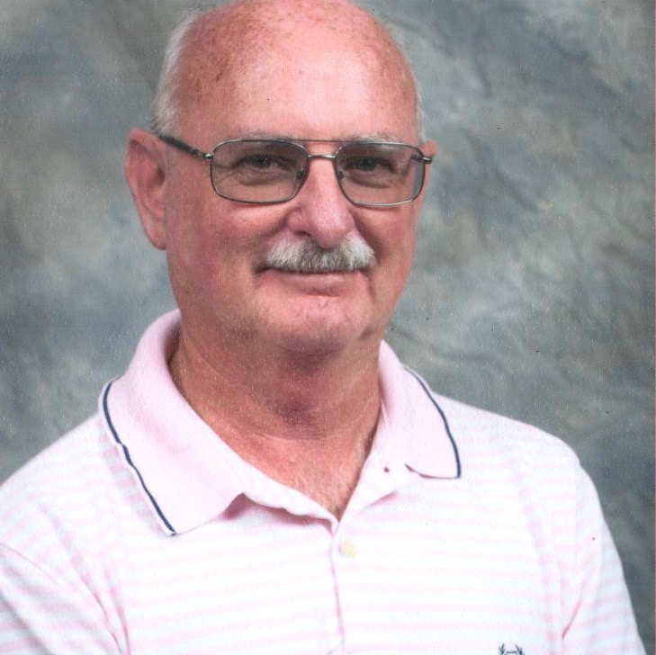
Inducted for Outstanding Contributions as a Friend of Central dewitt High School

Slide 3
Biography
Jim Hand has modeled his real passion for coaching youth basketball in our community. As a youth, he attended Welton grade school, a 1-room school house and St. Joe’s before graduating from Central in 1972. He has been coaching youth basketball for the past 23 years working with 17 different assistant coaches and hundreds of players from boys’ and girls’ teams of all ages. Jim has also been a basketball official since 1976 and officiated many games for our high school, middle school and for St. Joe’s. He has also been the voice of Saber Basketball for many years and does a great job of announcing the games at all levels. He is a former 4-H member and was a School Board member for 9 years, 7 of which he served as Board President.

Slide 4
Article from the Observer
It started as an opportunity to coach his own daughter. Twenty-three years later, and Jim Hand is still touching young lives on the basketball court. And as the Central DeWitt basketball program’s public-address announcer for more than decade, Hand has an up-close look at the impact he has had.
“Best seat in the house,” said Hand, who will be inducted into the Central DeWitt Hall of Fame as a friend to the district. “These players mean so much to me – they are like family.
“To see them have success on the court is pretty awesome.” Hand estimates that he has coached more than 180 young players – boys and girls – during his tenure, which started with his daughter Lindsay’s team. Then, son Scott was old enough to play, and Hand coached him, too. “After that there was always a connection with someone that had a child that played, like a brother or sister,” Hand said. “I have been connected with many great families.
“People have asked why and how I could have stayed involved in youth sports so long, and I tell them, if they knew the young people like I do, they would understand.” Even now, the joy of each new season remains.

Slide 5
The Observer (cont.)
“I love taking a new team and watching them grow and get better, and watch them become a basketball family,” Hand said. Part of the reason for that excitement is that Hand has not had to deal with the problems that have begun to plague youth sport. A testament, Hand said, to the area community.
“I talk to lots of coaches that do what I do, and they tell me of the difficulty that they have with getting players to practice, dealing with parents, and other issues that I just do not have,” he said. “That is a real tribute to the parents and students of this district.” Hand’s teams over the years have found plenty of success on the court, but it has been their character on the floor that Hand prizes most.
“My teams are known by officials to be respectful toward them and other teams,” he said. “I am proud of that.” Through it all, Hand has admired and treasured the support of his wife, Lori. “I could not have done any of these things without my supporting wife, who allowed me to coach way past my prime because she knew how much I enjoyed coaching,” he said. “She gave up lots of our time, and then has to endure listening about the games and practices, and acting like it is important to her also. “She is a special lady that I can’t thank enough.”

Slide 6
The Observer (cont.)
Hand has supported the Central DeWitt district in other ways as well. A 1972 graduate of Central, Hand was a member of the school board for nine years, during which he gained an appreciation for how much the school impacts a child’s life.
“I learned so much on what this school can do for young people of this district, and the great influence they have on the students and community.” About 15 years ago, Hand added a new job title – the voice of the Sabers’ basketball teams. At the gym to watch a game, Hand was asked to step in for an announcer who did not show.
He has been there since, giving him a perfect opportunity to keep tabs on some of his former players. “We are so blessed to have great high school coaches on both the girls and boys side, who work so hard for these players and treat them like coaches should treat players,” Hand said. “These kids work so hard, and when you watch them play for eight to nine years, you get pretty close to them.”
And those relationships have lasting power. “I see my former players, and they can’t wait to tell me what is happening in their lives, and I can’t wait to hear,” Hand said. “I have players that have their own children, and they tell me that they are waiting to have me coach their child. “I think that really says it all.”

Slide 7
Induction speech
Inducted for Outstanding Contributions as an Friend
Jim Hand has developed a real passion for basketball and the development of youth at our school. As a child, Jim was enrolled at Welton school before his parents moved north of DeWitt and attended a 1 room school house that taught 9 grades. He had 3 classmates. He later went to St. Joes and later onto Central where he graduated in 1972. He was a member of the 4-H. He went on to farm and sell real estate, which he has done since 1990. He owns his own appraisal business. He also became involved with local politics and ran for the School Board. He served on the Central DeWitt School Board for 9 years where he became very aware of the impact and influence the school has on our students and community during that time. He served as School Board President for 7 years. He also started coaching youth basketball, initially starting his coaching career with his daughter’s team. That passion for the game and most importantly the student-athletes continued for 23 years and still continues today. During that time, he has coached almost 200 players while working with 17 different assistants. He has coached both boys and girls teams of all ages. He has developed great and long lasting relationships with those players. Like many coaches at all levels, he appreciates taking a new team and

Slide 8
Speech (cont.) & video
watching them grow and get better. He enjoys watching them become a basketball family and it is for that reason that the pain regarding the tragic loss of Andrew Erickson last fall was so heart felt. respect they have shown to opposing teams and officials. He has an admiration for the parents and students of our District regarding the interactions he has had with them over the years as a coach. He has a love of his players and their affection towards him is something he considers very special. I have personally witness that affection many times at sporting events and have on occasion needed to remind our players that hugging our official before a game is probably not the best way to make an initial impression with opposing teams! Jim involvement as a basketball official is something he has been doing since 1976. He has officiated many games for our high school, middle school and for St. Joes. He has also been the voice Saber Basketball for many years and does a great job of announcing the games at all levels. He recognizes that he could not have been so heavily involved in his basketball endeavors if it were not for the support of his wife Lori. Their family includes son Scott and daughter Lindsay with husband Josh Scheinblum and grandson Julian. Please help me welcome the newest member of the Central DeWitt High School Hall of Fame, 2017 inductee… Jim Hand.

