Slide 1
John “Jack” maynard
Central Dewitt Hall of Fame
Induction Class 2018

Slide 2
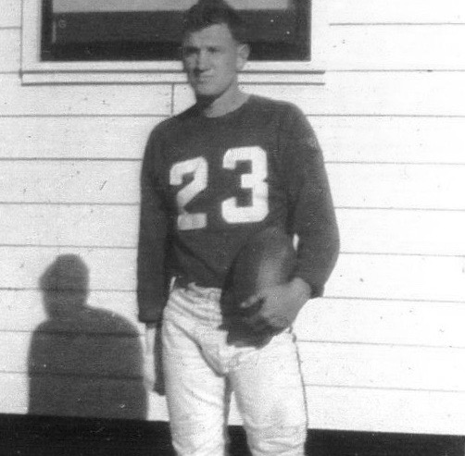
Inducted for Outstanding Contributions as an individual of Central dewitt High School

Slide 3
Biography
Jack Maynard is a 1953 graduate and earned the maximum 12 Varsity Letters for the DeHawks in his career. In football, he was nicknamed “Galloping” Jack Maynard, and still holds a program record, 3rd All-time for Total Offensive Yards in a Game with 312 yards. He was an All-Illowa and All-State football selection and earned All-State basketball recognition. He participated at the State Indoor & Outdoor Track meet all 4 years and was part of the 1951 Outdoor and 1953 Indoor Track Team Titles. He was a member of 3 State Championship relay teams and ran at the 1953 Drake Relays. He joined the Army and was Private 1st Class for the 4th Army 90th AAA Battalion and was a member of their 1956 Touch Football Championship.

Slide 4
Article from the Observer
Back when John “Jack” Maynard wore the number 26 on his back, some referred to him as “galloping” Jack Maynard for his football prowess. The running back was a bruiser, and 100 yard per game was commonplace for him.
However, Maynard is known for much more than just a football player. The all-around athlete participated in basketball and football, but his top achievements may have come in track. On the oval, Maynard on most of the DeHawks’ winning relay teams in 1951-53. He was a member of the 1951 outdoor track team championship squad, the first state championship for the school in any sport. Not to be outdone, Maynard was a member — and captain — of the 1953 indoor and outdoor championship teams in 1953.
As a member of those teams, Maynard’s performances included a first-place finish in the indoor 880 relay race in 1951, a title in the indoor two-mile relay, and the 1953 outdoor distance medley relay team. The running continued that year, as Maynard took part in the 1953 Drake Relays.
His running skills translated well to the gridiron, where Maynard played tailback on the DeHawks. “Jack was a tremendous football player,” said current Central Dewitt Activities Director Kurt Kreiter. Kreiter has compiled a personal all-century football team for DeWitt based on the team’s 100-plus

Slide 5
The Observer (cont.)
year history.
“Based on 10 years research I have done, Jack Maynard is one of my running backs on those teams,” Kreiter said. Maynard’s football accolades include All-Illowa honorable mentions in 1951. In 1952, Maynard led the entire league and eastern Iowa in touchdowns and points. He finished the 1952 season with 18 touchdowns, 119 points and averaged 6.1 yards per carry. He was also an honor roll member of the Tait Cummins WMT Radio State Football Team. The team was voted on by participating coaches across the state.
Maynard also starred in basketball where he earned all-conference and all-state recognition. The athlete played point guard and helped the Sabers to an impressive subdistrict win.
He earned letters in all three sports all four years of his high school career. Upon graduation, Maynard was given the Athletic Award by coach Harold Birney.
After high school, Maynard began college in Ventura, California, and briefly played football there. In 1955 he joined the U.S. Army and was Private 1st Class for the 4th Army 90th AAA Battalion. In the Army, he was a member of the 1956 touch football championship team.

Slide 6
The Observer (cont.)
Maynard worked for a telephone company for 42 years and coached little league baseball for 22 years.
He also groomed a love for bowling that developed as a child. For 60 years, Maynard has bowled at least once a week. He is a member of the DeWitt Bowling Hall of Fame. He married his wife, Donna, in 1958. Together they have one son, John Jr. Maynard also has three grandchildren and four great-grandchildren.

Slide 7
Induction speech
Inducted for Outstanding Contributions as an Individual
Jack Maynard is a 1953 graduate who was an outstanding sports athlete for the DeHawks during his era. He was an all-around player and earned 12 Varsity Letters while competing for the DeHawks. At that time, it happened to be the maximum number of Letters you could earn. Jack was a tremendous football player. We have had football at our school since 1916 and as some of you know I have put together my own All-Century Team when we celebrated our 100th year of football a few years ago. This is only my opinion, but based on the 10 years of football research that I have done, Jack Maynard is one of my running back selections on those teams! He played under Hall of Fame Coach Harold Birney and wore #26. He was sometimes nicknamed “Galloping” Jack Maynard. He was reported to be known as a “Crashing-Jarring” runner and had a number of games where he rushed for well over 100 yards. He was Honorable Mention All-Illowa in 1951 and in 1952 led the league and Eastern Iowa in Touchdowns and Points. He finished the season with 18 Touchdowns, 119 Points and a 6.1 yard per carry Average and was named to the 1st Team All-Illowa football team. He was also voted as an Honor Roll member of the WMT Tait Cummins State Football Team and had All-State recognition.As a basketball player he also earned All-Conference and All-State recognition. He played Guard and often led the team in scoring including a tremendous performance in a 63-62 Subdistrict win. His best sport might have been track. He was an outstanding runner and was on most of the winning relay teams during the

Slide 8
Speech (cont.) & video
1951, 1952 and 1953 seasons. He participated at the State Indoor and Outdoor Track meets all 4 years and was part of the 1951 Outdoor Track team title, the first State Championship for our school in any sport. He also was a Captain of the 1953 State Indoor and Outdoor State Championship Teams. He was a vital part of State Championship relay teams and won 4 State gold medals including the 1951 1st Place State Indoor 880 Relay team, the 1953 1st Place State Indoor 2-mile Relay and Mile Medley teams and 1953 Outdoor 1st Place Distance Medley Relay team. He also ran at the 1953 Drake Relays. He was awarded the Athletic Award by Coach Birney on graduation day. Although not school sponsored at the time, he also played American Legion baseball during the summer. After high school, he entered college in Ventura, CA and briefly played football for the Pirates In 1955 he joined the Army and was Private 1st Class for the 4th Army 90th AAA Battalion. While there he was a member of 1956 Touch Football Championship. Arriving home, he worked for the telephone company for 42 years and stayed involved in sports coaching Little League baseball for 22 years and bowling for 5 years. He is a regular bowler himself, which he has done once a week for 60 years! He has been inducted into the DeWitt Bowling Hall of Fame. In 1958 married his wife Donna and they had son John Jr. He has 3 grandchildren and 4 great-grandchildren. Please help me welcome the newest member of the Central DeWitt High School Hall of Fame, 2018 inductee… John “Jack” Maynard.

