Slide 1

Kurt
Kreiter
Central Dewitt Hall of Fame
Induction Class 2021

Slide 2
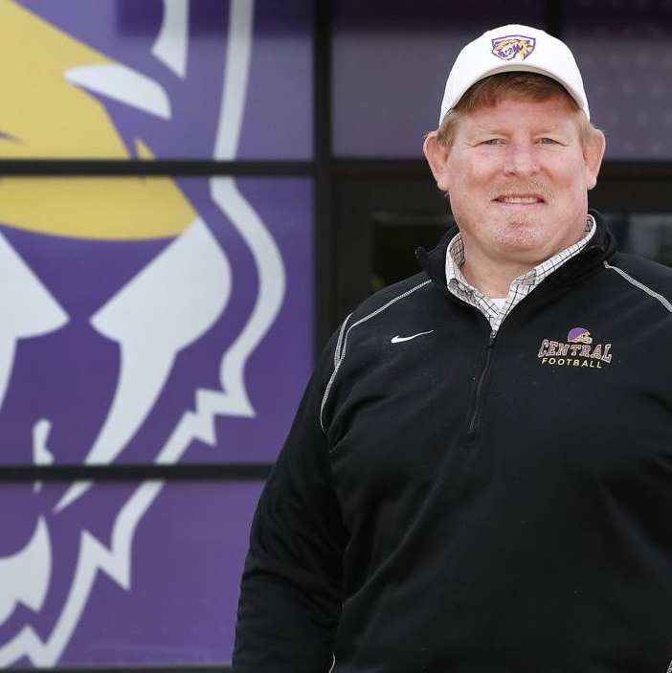
Inducted for Outstanding Contributions as an coach of Central dewitt High School

Slide 3

Biography
Kurt Kreiter was a HS Science Teacher for 25 years and MS/HS Activities Director for 8 years. He was the 2019-20 SE District AD of the Year. He was the Head Wrestling Coach from 1989-2009 compiling a 213-173 career record, coaching 46 State Qualifiers, 19 Place-winners, including Adam Grell’s 2002 Runner-up and Chad Rowson’s 1996 State Champion finishes. His teams hold 32 top-5 All-time program records and led the 2007 team to 4th Place at the IHSAA State Dual Tournament finish. He was the Head Football Coach for 11 seasons, leading the 2003 & 2007 teams to the 3A Quarterfinals and a 2008 undefeated regular season. He is the author of “Become the Inspiration: Leadership Principles & Fundamentals for the Beginning Coach.”He is a 1987 graduate of Augustana College and was a member of 3 undefeated National Championship football teams and as a collegiate wrestler was a team Captain, 2X Conference Champion, 2X NCAA Division III National Championship Qualifier and Academic All-American.

Slide 4
Article from the Observer
In another time, Kurt Kreiter might have been one of the world’s best geneticists. Instead, the longtime educator ingrained himself in the DNA of the Central DeWitt Community School District. After 33 years as a teacher, coach and activities director, Kreiter is set to join the Central DeWitt Hall of Fame — another school institution in which he has left his mark.
Fresh out of Augustana College, Kreiter recalled his feelings — “excited and nervous” — ahead of his first year teaching science, but things did not go quite as planned. “In a short amount of time, I realized that I had no idea what I was doing,” Kreiter said with a laugh. It got to a point that Kreiter spent his first Christmas break applying for graduate school while thinking maybe genetics or kinesiology was more up his alley than teaching. Kreiter, though, returned to the classroom, and it turned out to be a life-changing decision. “In short time, I found that I did enjoy teaching,” he said. “That first year, I knew all of the material, but teaching it is a whole different thing — and I loved it. “Sometimes I wonder what would have happened if I had left here and tried something else, would I have that same joy? I doubt it.”
Intro to athletics
Kreiter’s teaching extended outside of the classroom. He joined Central DeWitt’s coaching ranks in his first year and became the Sabers’ head wrestling coach in 1989.

Slide 5
The Observer (cont.)
Things were tough on the mat early. The Sabers started 4-42 in duals under Kreiter’s watch; they won just 17 in his first nine seasons. “If I was older, I don’t know if I would have been able to do it,” he said. “I was probably too young to know any better, too driven.”
But the trials and misadventures — Kreiter relayed one story where he and his brother, in a motivational tactic, declared that the next day’s practice would be voluntary and only the most committed need show up: only one wrestler did —were key building blocks of experience and self-reflection. “It was a good opportunity,” Kreiter said, “to see that what I’m doing isn’t working, so what can I change?”
For the wrestling program, the answer was exertion. If you were going to wear a purple and gold singlet, you were going to have to earn it. Or as Kreiter put it, the key to success in wrestling was to “make it hard.” “It turns out, some kids like it when you challenge them,” he said. “It became cooler to be a wrestler because they were the ones leaving the room drenched in sweat.”
The Sabers produced winning seasons in each of Kreiter’s final 10 years, going 153-63 — a .708 winning percentage — with the 2006-07 team becoming the first in program history to qualify for the state duals, where it finished fourth.

Slide 6
The Observer (cont.)
All told, Kreiter coached 46 state qualifiers, including a state champion (Chad Rowson in 1996), a state-runner-up (Adam Grell in 2002) and 17 other state place-winners.
On the gridiron
In 2001, Kreiter took over the reins of the Central DeWitt football program from Dwight Spangler. It was the culmination of a series of coaching assignments on the gridiron. Kreiter started as the defensive coordinator of the middle school football team before joining Spangler’s staff as a varsity assistant.
“I was happy that I had a whole year to show Coach Spangler my football (knowledge),” Kreiter said. “He moved me down to fresh-soph the next year.” Kreiter was the sophomore coach for five years before acting as Spangler’s defensive coordinator for three seasons. “Being at all of the levels (middle school, fresh-sophomore, varsity) really helped me learn about the whole program,” he said.
Using the same Wing-T offense that propelled his Augustana football team to a 49-0-1 record and four Division III national championships during his time there, Kreiter won 60 games in his 11 seasons as head coach of Central DeWitt.

Slide 7
The Observer (cont.)
The Sabers made the postseason four times during that span, including two trips to the 3A state quarterfinals. The 2007 and 2008 squads had the best two-year stretch in program history, going a combined 17-4 with two district titles.
Leading two different sports programs in short succession is not easy — even without a lot of the offseason activities that have become prevalent in high school athletics — but was made easier by Kreiter’s third team: his family. “The one thing that I really need to say is that my wife Jenny is unbelievable,” Kreiter said. “She’s been supporting me every step of the way and she did a great job raising the kids when I was not able to be there. “My family embraced the challenges — we were a coaching family.” Kreiter, in turn, has embraced another title: grandpa. Kurt and Jenny have two children — Casey and his wife, Meghan, and Haley and her husband, Wilson — and four grandchildren — Landen, Breckyn, Quincy and Jack.
Leaving a legacy
Those years of ups and downs as a coach make Kreiter a fountain of knowledge for Central DeWitt’s current roster of coaches, many of whom Kreiter had a hand in selecting as the school’s activities director. “The best part of the job is coaches coming in to my office and asking, ‘what should I do here?’ or ‘how can I accomplish this?’” Kreiter said. “In most cases, I’ve learned the hard way on a lot of those things, so I tell them what not to do.”

Slide 8
The Observer (cont.)
Kreiter has also extended his knowledge in other ways: he has worked as an adjunct professor for Ashford University, St. Ambrose University and the University of Memphis, and he is the author of the book, “Become the Inspiration: Leadership Principles & Fundamentals for the Beginning Coach.”
During his eight years as activities director, Kreiter served as the Southeast District Junior and Senior Director and twice presented at the Iowa High School Athletic Directors Association’s annual convention.
In another time, Kreiter might have been found in a laboratory. Instead, he found the perfect home. “There has not been a day I haven’t enjoyed coming to school.”

Slide 9
Induction speech
Inducted for Outstanding Contributions as an Coach
Kurt Kreiter recently retired after a 33⁻year career at Central DeWitt. He was a high school science teacher for 25 years, teaching both Biology and Anatomy & Physiology. During that time, he was the sponsor of our Science Club. He became the District MS-HS Activities Director in 2012 and stayed in that position for 8 years. He served as the Southeast District Junior and Senior Director and twice presented at the State AD Convention. He was named the Southeast District AD of the Year in 2019-20. He was a longtime coach serving as Head Wrestling Coach from 1989-2009. During the first 3 years as head coach, his teams were 4-42 in dual meets and experienced 50 dual losses before achieving10 wins and 100 losses before achieving 50 wins. After working on building the foundation, the program took off. He compiled a 213-173 career record, taking the 2007 team to a first ever appearance and 4th place finish at the IAHSAA State Dual Tournament. His teams won 3 Sectional and 2 District Championships and achieved 75 top 3 tournament finishes during his tenure. He coached 46 State Qualifiers including 19 Place-winners and 2002 135-pound Runner-up (Adam Grell) and 1996 160-pound State Champion (Chad Rowson). The 2006-07 team led the State in over Sportsmanship rating and he was selected twice as the Big Bend Coach of the Year and twice as the Southeast District Coach of the Year. He organized the Sabertooth Wrestling Club from a Park & Rec program in 1990 and developed the Millennium Freestyle/Greco Wrestling Club in 2001. He has also served as a middle school and varsity assistant coach

Slide 10
Speech (cont.) & video
within the program at various times. Similarly, he coached at all levels within our football program, starting at the middle school level, later serving as a longtime freshman-sophomore coach and eventually as the Varsity defensive coordinator, which included the 1999 State Quarterfinal team. In 2001, he was elevated to the position of Head Football Coach and led the Saber Football program for 11 years. His teams reached the 3A Quarterfinals twice and the Post-season 4 times. The 2007 and 2008 teams were the first ever to win District titles and the 2008 team became the 5th team in Saber history to finish the regular season undefeated. One of Kurt’s stand out memories was the 2003 team that defeated Oelwein in the Uni-dome and lost in the quarterfinals to Mt. Vernon. Kurt was very involved with the DYF organization. He earned his MA in 2005 from the Franciscan University and has worked as an Adjunct Professor for Ashford University, St. Ambrose University and the University of Memphis. He is the author of the book “Become the Inspiration: Leadership Principles & Fundamentals for the Beginning Coach”. During his youth, Kurt was a 3-sport athlete at North Scott High school and was selected into their Hall of Fame in 1996. He is a 1987 graduate of Augustana College in Rock Island, IL and was a member of 3 undefeated National Championship football teams. Those teams have been selected into their Hall of Fames. He was also a collegiate wrestler and was a team Captain, 2X Conference Champion, 2X NCAA Division III National Championship Qualifier and Academic All-American. He played competitive Rugby for the Quad City Irish for 12 years and twice was selected to the All-Iowa

Slide 11
Speech (cont.) & video
team. He has been married to Jenny for 33 years and they have two children and 4 grandchildren: Casey & Meghan with children Landen, Breckyn and Quincy and Haley & Wilson Rathjen with son Jack. Please help me welcome the newest member of the Central DeWitt High School Hall of Fame, 2021 inductee… Kurt Kreiter.

