Slide 1
Leah (Berst) Washmon
Central Dewitt Hall of Fame
Induction Class 2020

Slide 2
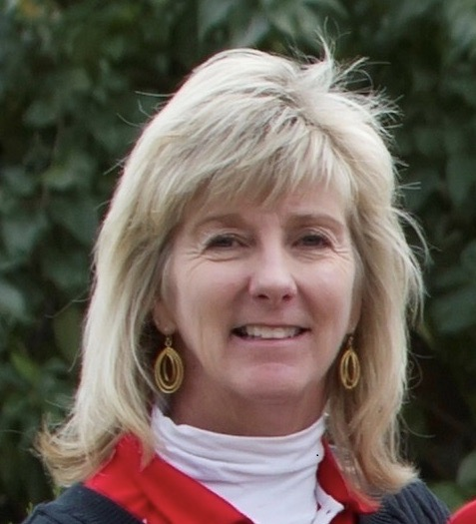
Inducted for Outstanding Contributions as a distinguished graduate of Central dewitt High School

Slide 3
Biography
Leah (Berst) Washmon is a 1979 graduate and a pioneer of female athletics and girls golf. She was a 3X Letterman and Sectional Medalist on a 10-2 Big Bend Championship team. She attended Florida State University and was a member of their Golf team from 1979-1983. She turned Pro in 1983 and started her own golf school, The Golf Institute in 1991. She earned membership into the PGA of America in 1987, and was a high school Head Coach at Ursuline Academy for 12 years, winning 5 State Championships. She was honored as the Texas Association of Private and Parochial Schools Coach of the Year and was appointed to the Board of Directors of the Northern Texas Section of the PGA of America, the first female to be on the Board in their 50-year history.

Slide 4
Article from the Observer
Marlene Berst, of DeWitt, and her late husband, Gordon “Gordy” Berst, moved into their home at Springbrook — right next to the golf course — when their daughter, Leah, was about five years old. While Gordy always was an avid golfer, Marlene believes that was about the time her little girl discovered her passion for it as well.“She was right around five years old,” Marlene related. “And I’m pretty sure that’s when she started golfing … every day, even way back then.”
All that practice paid off, given the fact the 1979 Central DeWitt graduate made her mark in her high school’s history with her many athletic achievements. And she didn’t stop there. In fact, Leah Berst Washmon continued to pursue her passion in college and beyond.
In addition to playing golf in high school, Washmon also was active in chorus, Chamber Singers, cheerleading, was a wrestling and football statistician and an honor roll student and state scholar. She also was a golf letterman and played all four years of high school. Throughout school, she playd in several state women’s and girl’s golf events, which resulted in multiple top 10 finishes. Washmon won first place at a junior event at Canyon Creek, setting a women’s course record. She placed second at the Iowa Girls Junior tournament, and won the Eastern Iowa Women’s Golf Tournament. In 1979, she placed third at the High School State Golf Tournament and won the state Father-Daughter Tournament. After she graduated from Central DeWitt, Washmon attended Florida State University and played golf for the FSU women’s golf team. She graduated with a

Slide 5
The Observer (cont.)
bachelor of science degree in education and began an internship at the Sawgrass resort in Florida, later taking a position as assistant golf professional. In 1984, she moved to Dallas to take another position as assistant golf professional. Washmon also worked as an assistant professional at another area country club at the same time. She earned her membership to the PGA of America in 1987. In 1990, she became the interim head golf professional at Stonebriar Country Club in Frisco, Texas. A year later, Washmon left to start her own golf school, The Golf Institute.
In 1999, she moved the institute to the North Texas Golf Center Driving Range and Golf Course that she owned until 2014. The next year, Washmon moved her golf operation to a golf course in Dallas, Texas, called Luna Vista. The golf institute is still in operation today, and she has taught more than 26,000 golf lessons through the Golf Institute and many outstanding high school and collegiate players. Washmon was also recently hired by the Highlands Performance Golf Center as its director of programming, where she instructs clients.
Throughout her career in the golf business, Washmon has donated her time and talent to her favorite charity, the Texas Scottish Rite Hospital for Children in Dallas. She also volunteered her time and provided lessons to various other Dallas charities and organizations over the years. Washmon also has remained heavily involved in high school golf and was a head coach for 12 years at Ursuline Academy in Dallas, where she and her teams won five state championships and several runner-up finishes.

Slide 6
The Observer (cont.)
She was voted Golf Coach of the Year by the Texas Association of Private and Parochial Schools. In 2012, Washmon achieved her quarter-century status with the PGA of America and still is a member. She also was appointed as an at-large director on the board of directors of the Northern Texas Section of the PGA, the first female to be on the board in its 50-year history. Washmon was subsequently voted to serve on the Northern Texas PGA Board of Directors for a two-year term, and recently was awarded the 2019 PGA Player Development Award from the Northern Texas Section.
As she reflected on hearing the news she was being inducted into her high school’s hall of fame, Washmon said her first reaction was to feel both honored and a bit shocked. “I was so surprised when I was selected,” she related. “I never figured I did much but play golf in high school and college. “I hope that I can inspire others to do what they love, even if it doesn’t seem like a realistic life path. If you feel strongly about something and work hard enough at it, one day you might be recognized for what you do. I feel very proud to be able to say I have helped people and trailblazed in the golf industry, doing something I love. It’s been fun to make lives better through teaching golf and being a mentor to so many. It’s also been a great accomplishment to open doors to create more opportunities for women within the golf industry. I would tell future generations to find a passion and pursue it, as you never know what impact you will make and who you may touch along the way.” Washmon and her husband, Dick, have two children, both of whom played elite-level golf in high school.

Slide 7
Induction speech
Inducted for Outstanding Contributions as a Distinguished Graduate
Leah (Berst) Washmon is a 1979 graduate of Central DeWitt and was one of the pioneers in female athletics and girls golf. She was active in drama, chorus, Chamber Singers, was a wrestling and football cheerleader & statistician and was selected to the Saber Wrestling Invitational Queen court. She was a member of NHS, an Honor Roll student and a State of Iowa Scholar. Leah played basketball as an underclassman but it was the game of golf where she excelled. She was a 3X Letterman while playing for Coach Peteresen. She was a Medalist at several meets including the Conference and Sectional meets on a team that went 10-2 and won the Big Bend Conference Title. Throughout her youth, she also played in a number of out of school events including several state golf meets. She finished in the top 10 several times. Those events included 1st place at a Junior event at Canyon Creek, where she set a new women’s course record. She placed 2nd at the Iowa Girls Junior tournament and won the Eastern Iowa Women’s golf tournament. As a Junior she placed 4th at Junior State and as a Senior placed 3rd at the Junior State tournament. She attended Florida State University and was a member of their golf team from 1979-1983. She graduated with a Bachelor’s degree in Education and began an internship at The Sawgrass Resort, later taking a position as an Assistant Golf Professional. She turned Pro in 1983. In 1984, her next move was to Dallas, where she took a position as an Assistant Golf Professional at an area country club. In 1991 she became the interim Head Golf Professional and

Slide 8
Speech (cont.) & video
started her own golf school, The Golf Institute. In 1999 she moved the Institute to the North Texas Golf Center and later to the Luna Vista golf course, where it is still in operation today. She has taught more than 25,000 golf lessons through the institute including many outstanding high school and collegiate players. She has also previously owned and operated a driving range and par 3 golf facility. She earned membership into the PGA of America in 1987, achieving her Quarter Century status in 2012 and is still going strong today! Leah was a high school head coach at Ursuline Academy for 12 years, winning 5 State Championships and several runner-up finishes. The 2010 team won by 54 strokes and the 2011 team won by 92! Several of her athletes have earned Division I scholarships. She has previously been voted the Texas Association of Private and Parochial Schools Coach of the Year. She was appointed to the Board of Directors of the Northern Texas Section of the PGA of America, the first female to be on that board in the 50-year history of the Northern Texas Section. Leah is married to Dick Washmon and they have 2 children: Wade of New York City, age 25, and Casey, age 20. Both kids played elite-level high school golf. Casey went on to play for the University of Mary Hardin Baylor women’s golf team for a year before transferring to Texas A&M where she currently attends. Leah was scheduled to be our commencement speaker last spring but unfortunately COVID changed those plans. Please help me welcome the newest member of the Central DeWitt High School Hall of Fame, 2020 inductee… Leah (Berst) Washmon.

