Slide 1
Lindsey knake (smith)
Central Dewitt Hall of Fame
Induction Class 2023

Slide 2
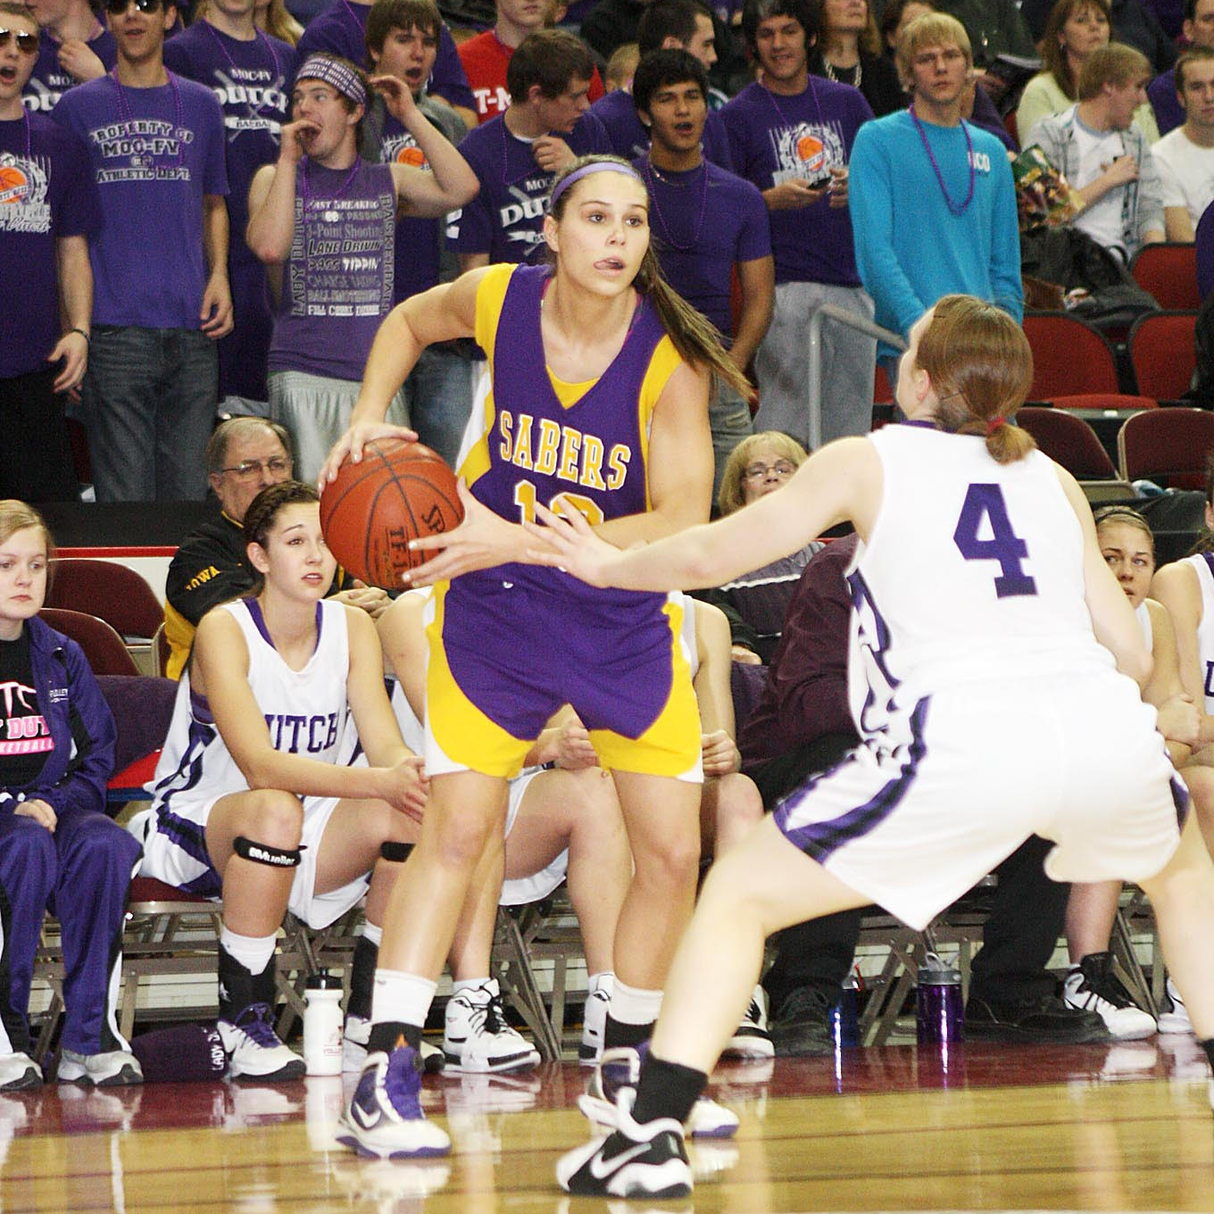
Inducted for Outstanding Contributions as an Individual of Central dewitt High School

Slide 3
Biography
One of the most accomplished athletes in Saber history and 2011 Quad City Times Female Athlete of the Year was Lindsey Smith. She earned 17 Varsity Letters as a Saber. She was Honorable Mention All-WaMaC in Cross Country and as a Softball player, was 4X All-Conference and All-State. She was a 9X State Track Qualifier, placing 3rd in the 400 Hurdles in 2010. As a Basketball player she earned 4, 1st Team All-WaMaC selections, 4, All-State selections, including 3, 1st Team honors. She became the program’s All-Time leading Scorer with 1,457 points, and held career records for Assists, Steals and 3-Point Field Goals. She helped her team earn 2 WaMaC and District titles and a 2011 trip to the 3A Semifinals. She played Division 1 college basketball.

Slide 4
Article from the Observer
Hampered by a late hiring and an inexperienced roster, the first Central DeWitt girls basketball team under head coach Mark Kurtz won a single game. The Sabers, however, entered the 2007- 08 campaign with a sense of optimism. Not only did they have a season — and just as important — an offseason working with Kurtz, but help was on the way. Joining the varsity program that winter was a talented freshman class led by 2023 Central DeWitt Hall of Fame inductees, Lindsay (Smith) Knake and Jen Keitel. What the Sabers accomplished over the next four years more than likely exceeded that optimism. During Knake and Keitel’s time in purple and gold, Central DeWitt went 81- 17, won a pair of WaMaC East crowns and ultimately advanced to the 2011 3A state semifinals.
The duo’s presence had an immediate impact: Knake and Keitel combined for 34 points in their very first varsity contest and before December had even started, the Sabers had more victories (four) than they did the year prior. “With their talent and skill level there is question they belong at the varsity level,” Kurtz said. “I think our first four games proved that.” Central DeWitt ended up winning 17 games in 2007-08 before bowing out to the reigning 3A state champion. Knake was the team’s leading scorer, dropping in 14.3 points per game, while also coming up with a team-high 54 steals, 43 assists and 106 rebounds. Her play earned her a first-team spot on the All WaMaC East squad — the first East player to be named to the first team since the conference was rearranged in 2003-04 — and the Saber was one of

Slide 5
The Observer (cont.)
just three freshmen across Iowa to be named to the Iowa Newspapers Association (INA) all-state team, where she was a third-team pick in 3A. Keitel added 211 points of her own and paced the Sabers in both rebounds (131) and blocked shots (26), while also coming up with 25 steals. She was just the second WaMaC East freshman to be named to the All-WaMaC East second team since 2003- 04.
Central DeWitt was even better in 2008-09, going 19-4, including a perfect 14-0 mark in the WaMaC East. This time, both Knake and Keitel earned first-team All-WaMaC East honors, a feat they would repeat again as juniors and seniors. They combined for over 60 percent of the team’s scoring and spearheaded a defense that held 19 different foes under 40 points, highlighted by a 37-30 3A regional victory over MAC champion Davenport Assumption, the reigning 2A state champion. Knake earned first-team all-state honors after a campaign in which she averaged 15.6 points per game, dished out 128 assists, grabbed 105 rebounds and collected 62 steals. Keitel added 12.2 points per game, again led the Sabers with 164 rebounds and 47 blocks. She impressed Kurtz by dishing out 53 assists of her own, while also coming up with 44 steals.
The Sabers repeated as WaMaC East champions in 2009-10, going 13-1 — Central DeWitt avenged the lone loss to Mount Vernon, handing the eventual

Slide 6
The Observer (cont.)
2A state champions its final setback of the winter — part of a 21-4 mark overall.
Both Knake and Keitel were honored with INA all-state honors, the former on the first team, the latter on the third. Just a single point separated the duo with Keitel pouring in 370 and Knake 369 (both averaged 14.8 points per game). Keitel pulled down a personal-best 195 rebounds (7.8 per game) and had 46 assists, 44 steals and 32 blocks. Knake added 182 rebounds of her own and had 153 assists and 76 steals — all personal- bests.
Central DeWitt advanced to the regional finals — one game away from state — but fell to eventual 3A runner-up Waukon. That provided extra motivation for Keitel and Knake’s final prep season. The Sabers responded, winning 24 games in 2010-11. The campaign featured impressive regular season victories over 3A No. 2 Mount Vernon and 4A No. 5 Cedar Rapids Washington — the latter victory coming as part of Rivalry Saturday at the U.S. Cellular Center in Cedar Rapids — and 12 more WaMaC East victories.
Most importantly, the season ended in Des Moines as the Sabers dispatched Maquoketa, Dubuque Wahlert and finally Decorah in the regional tournament to punch the program’s first state tournament ticket since 1995. The Sabers’

Slide 7
The Observer (cont.)
quarterfinal game with MOC-Floyd Valley proved to be bittersweet as Central DeWitt handed the Lady Dutch their very first loss of the season — Keitel had a double-double with 17 points and 15 rebounds — but did so only after losing Knake to a significant knee injury. Playing without one of their star seniors, the Sabers battled Mount Vernon in 3A semifinals, holding the Mustangs 15 points under their scoring average, but were limited to 29 themselves in a 41-29 setback.
Keitel accounted for nearly half of the points with 13 and added six rebounds, two assists and two blocks, while being named to the all-tournament team. Ultimately, both Keitel and Knake were selected to the INA 3A all-state first team after a season in which the pair outscored 96 teams in the state with their 807 combined points.
Knake led the Sabers with 410 points (an average of 15.8 per game), while grabbing 159 rebounds, dishing out 131 assists and coming up with 82 steals. All told, Knake poured in 1,467 career points, which still sits as the most among Central DeWitt and Observer-area girls basketball players. Her 455 career assists, meanwhile, are also a school record, while her 274 steals are second for a career. “I think Lindsay is one of the best all- around players that the conference has seen in some time,” Kurtz said during her senior campaign. “She is like a five-tool player in baseball because she can handle

Slide 8
The Observer (cont.)
the ball, she can defend, she can shoot, she can pass and she can rebound.” “She has had a tremendous four years with the team and she’s going to find her name in the record books for a long time.” Keitel added 397 points in her senior campaign with 198 rebounds, 92 assists, 59 steals and 39 blocked shots. Those totals gave her 1,258 points for her career, which currently ranks third in program history and sixth among all Observer-area girls players. Keitel’s 688 career rebounds remain a school record and the highest total for any area girls basketball player and her 144 blocked shots still ranks second in school history.
“Jennifer made it so difficult for teams because of her presence in the post and her ability to pass the ball,” Kurtz said after her senior year. “The improvement that [she] has made over the last four years was startling.” Basketball was not the only sport in which Knake and Keitel excelled while at Central DeWitt.
Both were state track qualifiers in 2010 with Keitel making it in the discus — she threw a season-best 109-2 and Knake qualifying in the maximum four events: the 400-meter hurdles and the shuttle hurdle, 4x200 and 4x400 relays. Knake ended up as a nine-time state track qualifier and her 2010 clocking of 1:05.79 in the 3A 400-meter hurdles gave her a third-place finish.

Slide 9
The Observer (cont.)
She still has the third-fastest 100-meter hurdles time for 33-inch hurdles (16.56) in program history, while her time of 1:05.59 in 2010 is the fourth fastest for the 400- meter hurdles.
Keitel and Knake were also four-year starters for the Sabers’ softball team, seeing their first varsity action as eighth- graders. Keitel, in fact, led Central DeWitt in batting average (.390), doubles (12) and RBIs (34), while racking up 53 hits as an eighth grader. Knake added 50 hits of her own and was second on the team with 27 runs, while batting .352. Both players earned spots (Keitel on the second team, Knake received honorable mention) on the All-WaMaC East squad. Keitel ended up leading the Sabers in RBIs in all four of her varsity seasons and earned the respect of opposing pitchers who helped her also lead the team in walks twice. She earned All-WaMaC East honors again in 2009. After earning honorable mention honors again as a freshman, Knake was an All- WaMaC East first-team selection in both 2009 and 2010. She led the Sabers in hits (a combined 114), runs (75), batting average (.438) and stolen bases (62) in those campaigns, which both ended with all-state honors.
Knake also made an impact as a cross country runner. She ran varsity in four different WaMaC Conference meets and produced Central DeWitt’s top performance in three of them, highlighted by a 21st-place finish in 2009. For

Slide 10
The Observer (cont.)
her athletic excellence, Knake was honored as the 2011 Quad City Times Athlete of the Year becoming the second Saber — Steph Marsh was the first in 2003 — to earn the distinction.
A cross country participant as well, Keitel spent the spring of her senior year as the goalkeeper for the Central DeWitt girls soccer team. And it was a memorable debut as Keitel earned first-team All-WaMaC East honors for her play. The Sabers won nine games — the second-most in program history at that point — with Keitel helping win a school-record eight of them via shutout. The senior finished the year with over 200 saves and ranked among the conference leaders in both save percentage and goals against average.
Both Hall of Fame inductees continued their hoops careers collegiately. Keitel was a two-time All-Missouri Valley Conference (MVC) honoree for the University of Northern Iowa, including a first-team selection in 2013-14, and was twice named was named to the MVC Scholar-Athlete team. She became the 23rd Panther to reach 1,000 points during her senior campaign in 2015 16, a season in which UNI won its second regular season MVC title and reached the third round of the WNIT. Keitel finished her career with 1,082 points — 19th-most all-time in program history — and still ranks among UNI’s career leaders in field goal percentage (.486, 10th-best), offensive rebounds (276, sixth-most) and blocked shots (106, fifth- most).

Slide 11
The Observer (cont.)
Knake recovered from her knee injury and appeared in 26 games, starting two, during her freshman season in 2011-12 for the University of Wisconsin. Her first start for the Badgers came against Iowa. She then transferred and played two seasons at Illinois State University, averaging 8.0 points per game and finishing second on the team in assists in her first year and averaging 8.6 points in her second year, but again battled injuries. Knake closed out her career at St. Ambrose University, reuniting with Kurtz, who was an assistant coach, and earning a spot on the All-Chicagoland Collegiate Athletic Conference team after leading the Bees — an NAIA Division II tournament qualifier — in both assists (3.7 per game) and steals (1.9), while also averaging 11.9 points and 5.8 rebounds.
Keitel graduated with Bachelor of Arts degrees in both criminology and psychology and later earned her master’s degree from Upper Iowa University in sport administration with an emphasis on coaching and leadership. She pursued a career in law enforcement and was nominated as vice president by her Law Enforcement Academy graduation class and was honored with the Coler-Williams Memorial Award given to one recruit from each South Dakota Law Enforcement Academy session. Keitel has become a DARE officer and a patrol training officer and in 2022 was named the Employee of the Year for the city of Yankton, South Dakota, where she currently resides with girlfriend, Kayla, and dog, Nashville “Nash.” Keitel also spent time as a volunteer coach for Wartburg College, helping lead them to a 56-4 mark

Slide 12
The Observer (cont.)
during her tenure with two conference crowns and two berths in the NCAA Division III national tournament.
Knake received her degree in psychology at St. Ambrose and later earned a master’s in organizational leadership from Goodwin University. She also has spent time in coaching, serving seven years as an assistant for Cornell College in Mount Vernon, where she was also a Senior Woman Administrator and Assistant Athletic Director. Knake and her husband, Ben, welcomed their first child, Jett, in August 2022. Knake is currently working in HR for Elite Stone Fabrications.

Slide 13
Induction speech
Inducted for Outstanding Contributions as an Individual
One of the most accomplished multi-sport athletes in Saber history is 2011 graduate Lindsey Smith. Because of her dominance, she was recognized as the 2011 Quad City Times Female Athlete of the Year, only the 2nd Saber to ever earn this prestigious award. During her high school athletic career, she earned an incredible 17 Varsity Letters while competing in Cross Country, Basketball, Track & Field and Softball. She was also an outstanding student and leader and volunteered in the Special Olympics and Best Buddies programs and was a football statistician. She was a member of the NHS. Lindsey ran Cross Country and was often the programs top female finisher during meets, earning Honorable Mention All-WaMaC honors in 2009. She was an outstanding Softball Shortstop and was selected as a 4X All-Conference and All-State player. She excelled as a Track athlete and was a 9X State Qualifier. She placed 3rd in the 400 Hurdles during her Junior year and still holds the All-Time program record in that event at 1:05.79. She is also part of #1 program records for the 30 and 33 inch Shuttle Hurdle Relay Teams and is a member of 4 other Relay Teams that hold top 10 records.Basketball though, was her signature sport. Playing for Coach Mark Kurtz, she excelled even as a Freshman. She was the first ever freshman player to earn a 1st Team All-WaMaC selection, which was a unanimous selection. That season she would lead her team in Scoring (14.9 points/game), Steals (42) and 3-Point Shots (23). Her Senior year, she helped lead the team to the 3A Semifinals in a

Slide 14
Speech (cont.) & video
Quarterfinal win against MOC Floyd Valley in which she would tear her ACL. That would greatly hamper a drive to a State Title. During her career she would go on to earn (4) 1st Team All-WaMaC selections, (4) Class 3A All-State selections, including (3) 1st Team honors. She was a 3X Team Captain, helping her team earn 2 WaMaC and 2 District titles. She became the program’s All-Time leading Scorer with 1,457 points, and at graduation also held career records for Assists, Steals and 3-Point Field Goals. She was selected to play in the IBCA Elite All-Star Game and was a member of Iowa’s 17U State Championship team. She was honored as a McDonald’s All-American nominee. She signed to play Division 1 basketball at the University of Wisconsin, and while still rehabbed her injured knee, still played in 26 games that Freshman year with 2 starts, one of which was against Iowa. She transferred to Illinois State during her sophomore year where she continued to deal with several injuries before ultimately deciding to finish her career at St. Ambrose University. During her final season, she helped the Queen Bees to a CCAC Runner-up finish and a berth in the NAIA National Tournament. Lindsey was recognized as an All-Conference selection. During her college career, she was also involved in Student Athlete Advisory Committee, Jack North’s Leadership Academy, and volunteered for Big Brothers Big Sisters. She received her degree in Psychology from St. Ambrose and her Master’s in Organizational Leadership from Goodwin University last spring. She has spent the last 7 years coaching college basketball at Cornell College in Mount Vernon,

Slide 15
Speech (cont.) & video
where she has previously served as the Senior Woman Administrator and Assistant Athletic Director.She met her husband Ben; a Cornell graduate and football player and they were married in June of 2021. They had the ir first child Jett in August of 2022. Their family also includes their dog, Ellie. She is currently working in HR for Elite Stone Fabrications and plans to continue to assist with the Women’s Basketball program at Cornell. She is still an active runner and runs 5Ks and half-marathon to fuel her competitive fire. Please help me welcome the newest member of the Central DeWitt High School Hall of Fame, 2023 inductee… Lindsey (Knake) Smith.

