Slide 1
Mary Landau
Central Dewitt Hall of Fame
Induction Class 2019

Slide 2
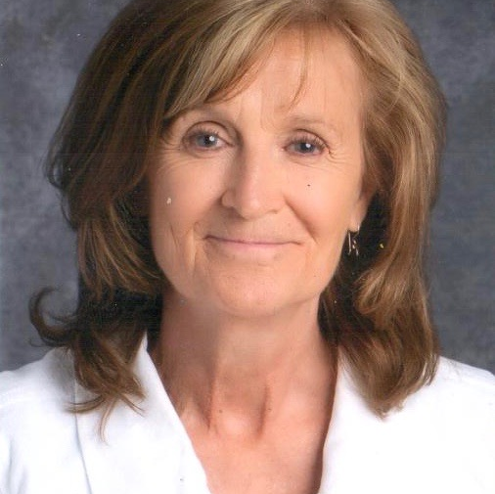
Inducted for Outstanding Contributions as a Friend of Central dewitt High School

Slide 3
Biography
Few people have been more instrumental in the last three decades at creating a positive atmosphere at our school than Mary Landau. Mary is a 1969 graduate from West Sioux Community HS in Hawarden, Iowa, and greeted students, staff, parents, and visitors from her front office desk at Central DeWitt High School since the fall of 1987. She is the epitome of the word “class” and has been instrumental in helping students & staff through tough times, comforting those that are sick, making new students feel welcome or trying to accommodate everyone’s constant needs. She has been most well-known for reading the school announcements and served as a long-time Ticket Taker at events and Secretary for the Education Foundation.

Slide 4
Article from the Observer
Mary Landau says her favorite memories of working as a secretary at Central DeWitt High School are simply too many to list. Homecoming, including the dress-up days, is at the top of the list. Landau and her former co-worker, Linda Ryan, always participated in the dress-up days right along with the students. One year, the pair even dressed as Vanna White, and made a “Wheel of Fortune” wheel, which sat in the office and included prizes.
Landau assisted for many years with the annual Grand March at prom, and she loved seeing the students dressed so nice. She also enjoyed helping with commencement exercises — which she did for all 32 years of her career at the school before retiring this past spring. Even after more than three decades of service, Landau never considered going to work a chore. She figured, the more hustle and bustle there was in the office, the better.
Landau’s duties were almost too many to note, but what always motivated her and what she always valued most about her work were the students. She endeavored to get to know each and every one of them by name; to listen to and comfort them when they had a problem or cheer them on when they had good news to share.
Landau’s youngest daughter, Carrie Bacha, a 1992 graduate of Central DeWitt, said her mother’s caring and concern for students continued after they graduated from school.

Slide 5
The Observer (cont.)
“She wanted to see them succeed, and still does,” Bacha wrote in an email. “My mom is constantly telling me about students, and how well they are doing or what new job they received. Every person I meet who only knows me because of my mom will say things like, ‘She is the best, she is wonderful, she is such a great person and she has the best heart.’”
Landau ended up getting the job at the high school back in 1987 thanks to a tip from a local Realtor, after she and her husband, Gary, and their two daughters, Jenny and Carrie, moved to town from Minnesota. She had grown up on a farm in Hawarden, Iowa, and graduated from West Sioux Community High School in 1969. Three years later, she married Gary, her high school sweetheart. Landau learned about serving her community from her mom, who was very involved in volunteering. Bacha said, in addition to all of her responsibilities at the school, Landau always would be thinking of others. “Growing up, we would tease her when she would make a big batch of lasagna and/or chicken noodle soup for parents of sick friends, families going through hard times, and, at times, simply to welcome a new family.
“She would be busy at work, would take tickets for a game, take care of her motherly duties, but would then take care of other people by making them something from her heart.” In addition to taking tickets at all kinds of sporting events, Landau also kept track of the money from concession stands, vending machines and school events. She worked as the secretary

Slide 6
The Observer (cont.)
for the Central DeWitt Educational Foundation for many years, and she loved being able to assist an organization that gives so much to students and teachers.
Central DeWitt Activities Director Kurt Kreiter described Landau as the high school’s greatest ambassador. His own mother had been a high school secretary, so Kreiter understood how essential the job is to the well-being of the school. The two worked together for all of Landau’s 32 years, and they forged a genuine friendship. “I am so glad I got to spend my entire career working with her,” he related. “I’m going to miss seeing and talking with her.” Current middle and high school principal George Pickup said no one could be a bigger Saber fan than Landau. “I think this has been Mary’s second family,” he said of staff members at the school. “What I really appreciate about her is all the connections within our community that she’s made. The biggest thing I see in Mary is the pride she has in our district. How truly dedicated she is. She really is the face of the high school.”
Bacha estimates the number of students, co-workers and families whose lives her mom has touched hovers somewhere in the thousands. “She has provided help to countless graduates; 32 classes of kids,” Bacha shared. “On average, Central DeWitt has 115 graduating seniors each year. Roughly 4,000 students and families were directly involved with her at some point, and it is my belief, they are better for it.”

Slide 7
Induction speech
Inducted for Outstanding Contributions as a Friend
Few people have been more instrumental in the last three decades at creating a positive atmosphere in our high school than Mary Landau. She has done it in a very simple, often forgotten… yet extremely important way… by exhibiting a positive attitude. Mary has greeted students, staff, parents and visitors from her front office desk at the high school since the fall of 1987. She demonstrated by example that if you do the little things the right way over a long period of time, they collectively add up and can make a tremendous impact on those around you! Mary is a 1969 graduate from West Sioux Community HS in Hawarden, Iowa. After graduation she completed a course at an airline school in Minneapolis, MN. In 1972 she married her high school sweetheart; Gary Landau and they started a family. They later moved to Tipton, IA for 4 years and then back to Minnesota. They were now a family of 4 with the addition of daughters Jenny and Carrie. It was at that time that Mary took her first secretarial job at a vocational school. In 1987, the family moved back to Iowa, this time to DeWitt, where Gary had gained employment as a Court Reporter for the State. Mary started at Central DeWitt that November. There are not too many people employed in our District over the years that have been more revered than Mary. She is the epitome of the word “class”. She is the consummate professional and someone who you could tell through her daily actions, really loved being at work every day. She became the “face” of our high school and one of our greatest ambassadors, because she was often

Slide 8
Speech (cont.) & video
the first one to greet students, staff, parents and guest when they arrive at or called our school. She has been instrumental in helping students & staff through tough times by showing empathy and compassion when she was often the first one to hear, and have to pass along personal issues. She has been incredible and comforting those that are sick, making new students feel welcome or trying to accommodate everyone’s constant needs for transcripts, passes, scheduling and rescheduling and then rescheduling again. We also know she has a toughness about her that has been critical on the front line, when having to handle upset students and adults who first enter the office area in a not-so-good mood. Mary had a knack of knowing how to diffuse a situation and when to light a fuse! Of course, she has been most well-known for reading the school announcements. Students revolted one year when a decision was made to do away with that, at which point her golden voice quickly returned to the mic. Everyone has got a chuckle at one time or another listening to her stumble a bit through a tough section of announcements only to hear her pronounce… “Let’s try that one again!”She was a long-time volunteer as a Ticket Taker and has often been seen counting and recounting money before and after school or to help organize grant applications or events for the Education Foundation that she was the long-time secretary for. She has been married to Gary for 47 years now… she thinks… They have 4 grandchildren: Jenny & Stan with Emmerson, Colton, Jack & and Carrie & Tim with Mackenzie. Please help me welcome the newest member of the Central DeWitt High School Hall of Fame, 2019 inductee… Mary Landau.

