Slide 1
Matthew niemann
Central Dewitt Hall of Fame
Induction Class 2017

Slide 2
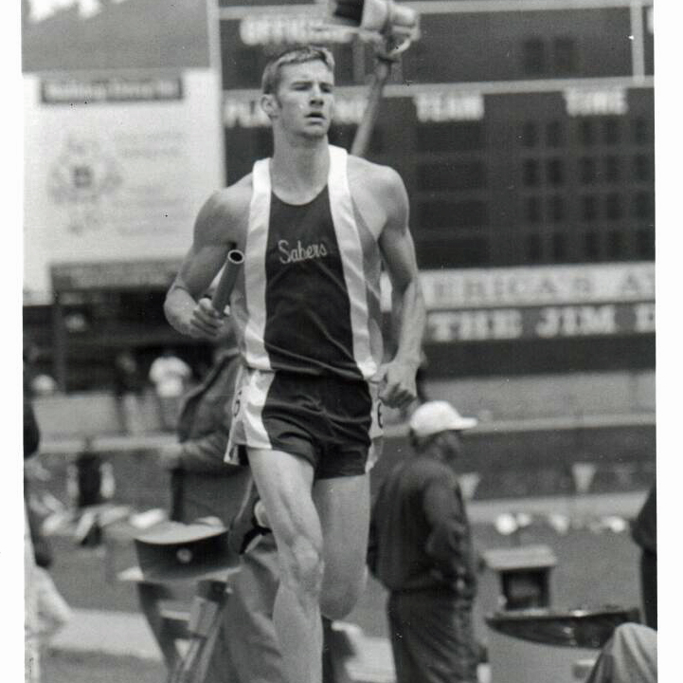
Inducted for Outstanding Contributions as an individual of Central dewitt High School

Slide 3
Biography
Matt was the valedictorian of the 2002 graduating class with a 4.0 GPA. He was a member of Student Council, NHS and served as Junior Class President. He was a State of Iowa Scholar and attended Boys State. He was a 2X basketball Letterman and All-Conference. He was a 3X Cross Country Letterman, 2X Individual Conference Champion and was selected 1st Team All-State as a junior. He placed 23rd, 18th, and 4th at the State Meet. He was a football Letterman. In track he was a 4X Letterman, 3X Drake Relays and 4X State meet qualifier and earned medals in each of those season. In 2002, he won the 3A State Championship 800-meter run in the time of 1:55.41. His record still stands and he is part of 5 other All-Time school records.

Slide 4
Article from the Observer
To hear Matt Niemann tell it, his high school years weren’t all that unusual.
“Pretty typical,” he said. “Three-sport athlete, and then I tried to stay about as involved as I could for what was offered at DeWitt at the time.”
Other than that, it was “going to the school dances and trying to get through my high school years in one piece.”
Niemann, 34, is a 2002 graduate of Central DeWitt High School. After a career as an industrial engineer, which took him to the Far East, he moved back to DeWitt in 2012 to work with his family’s farming operation while owning and managing an aerial application business.
He distinguished himself in several ways in high school – one of five valedictorians in the Class of ’02, a 4.0 GPA, member of the Student Council, National Honor Society and served as junior class president, recognized as a State of Iowa Scholar and attended Boys State.
But he also made his mark on the court, track and field. If he bought a jacket for each time he lettered in a sport, he could go a week and a half without wearing the same one twice.

Slide 5
The Observer (cont.)
He lettered twice in basketball and was all-conference his senior year. He was on a team that beat Assumption to earn a sub-state appearance at the U.S. Cellular Center as a junior and earned All-Conference recognition his senior year. He lettered three times in cross country,
He excelled in cross county, lettering three times, winning the individual conference champion twice, and being chosen first team all-state his junior year.
In track, the four-time letterman competed at the Drake Relays in 2000, 2001 and 2002, earning two medals in those years. He was a four-time state meet qualifier, earning medals each year. He was part of a record setting 4x800 relay team and, in his final race as a Saber, won the 2002 3A state championship in the 800 meters, setting a school record that stills stands.
In his senior year, he tried football, lettering as a receiver and special teams player and earning academic all-state.
While those successes were a result of hard work and athletic ability, his success in the classroom was a matter of “paying attention in school and not sitting in the back of the room.” But he also gives credit to

Slide 6
The Observer (cont.)
teachers “that engaged me and didn’t keep me bored. They would teach me to what level they thought I was at.”
He particularly enjoyed math and physics, which led him to earn an engineering degree at Iowa State University.
He also credits his success to his upbringing in a smaller agricultural community.
“I didn’t feel like I was a number,” he said. “Everybody knew each other by name. I could almost rattle off my entire graduating class and knew everyone in some way shape or form. The teachers stayed the same; I was able to grow with them. There wasn’t a huge turnover rate that wasn’t allowing me to connect to those teachers. They knew who I was and how we interacted. We could just work on advancing ourselves.
“I feel very, very fortunate to come from DeWitt, U.S.A.”

Slide 7
Induction speech
Inducted for Outstanding Contributions as an Individual
Matt was truly an outstanding student-athlete for the Sabers, graduating in 2002. He may have been known for his running achievements but he excelled in many more areas than that. Matt was one of 5 valedictorians in the Class of 2002, graduating with a 4.0 GPA. He was a member of the Student Council, NHS and served as the Junior Class President. He was also recognized as a State of Iowa Scholar and attended Boys State. Matt excelled at all of his athletic endeavors. He was a 2X Letterman for the basketball team. He was on a team that beat Assumption to earn a sub-state appearance at the US Cellular Center as a junior and earned All-Conference recognition his senior year. He was an outstanding cross country athlete and was a 3X Letterman, 2X Individual Conference Champion and was selected 1st Team All-State as a junior. He placed 23rd, 18th and 4th at the State Meet from 1998-2000 and was inducted into our Hall of Fame class of 2011 with the 2000 Class 2A State Champion Cross Country team. That team was dominant during the year and scored 69 points at the State meet with the top 5 Sabers finishing between 4th and 21st place with only 61 seconds separating them! In 2001, my first year as a head football coach, I got the unlikely chance to coach Matt in football his senior year. Of course even without a background in the sport he was outstanding. He was a Letterman and our Academic All-State selection. He was a tremendous receiver and special team’s player as well as a great

Slide 8
Speech (cont.) & video
leader. Matt was an incredible runner and track was no exception. He was a 4X Letterman and competed at the Drake Relays in 2000, 2001 and 2002 earning 2 medals during those years. He was a 4X State meet qualifier and earned medals in each of those season. The 4 x 800 team he was a member of, established a new school record of 7:56.69 at the state meet in 2000 where he got the opportunity to run with his brother Luke, Brandon Maher and Treye Kettwick. He set another school record in 2002 when in his final race as a Saber, he won the 2002 3A State Championship in the 800-meter run in the time of 1:55.41. That record still stands today. He is part of an additional 5 All-Time top ten performances for Central DeWitt track. Matt attended Iowa State University after graduation and earned a Bachelor of Science degree in Industrial Engineering with a minor in Business Management. He was the recipient of the Dorothy Avery Clark & Maurice R. Clark Engineering Scholarship. After an internship with John Deere he accepted a job with Kreg Tool Company in Huxley, IA while working as an engineer refining the manufacturing process and traveling overseas to China and Taiwan. In 2012 he moved back to work with the family farming operation with his wife Erin where they farm corn and soybean crops as well as own and manage SkyShare LLC, a aerial application business of crop care products. They have two children, Mae Alice and William Leonard.Please help me welcome the newest member of the Central DeWitt High School Hall of Fame, 2017 inductee… Matthew Niemann.

