Slide 1
Todd cox
Central Dewitt Hall of Fame
Induction Class 2018

Slide 2
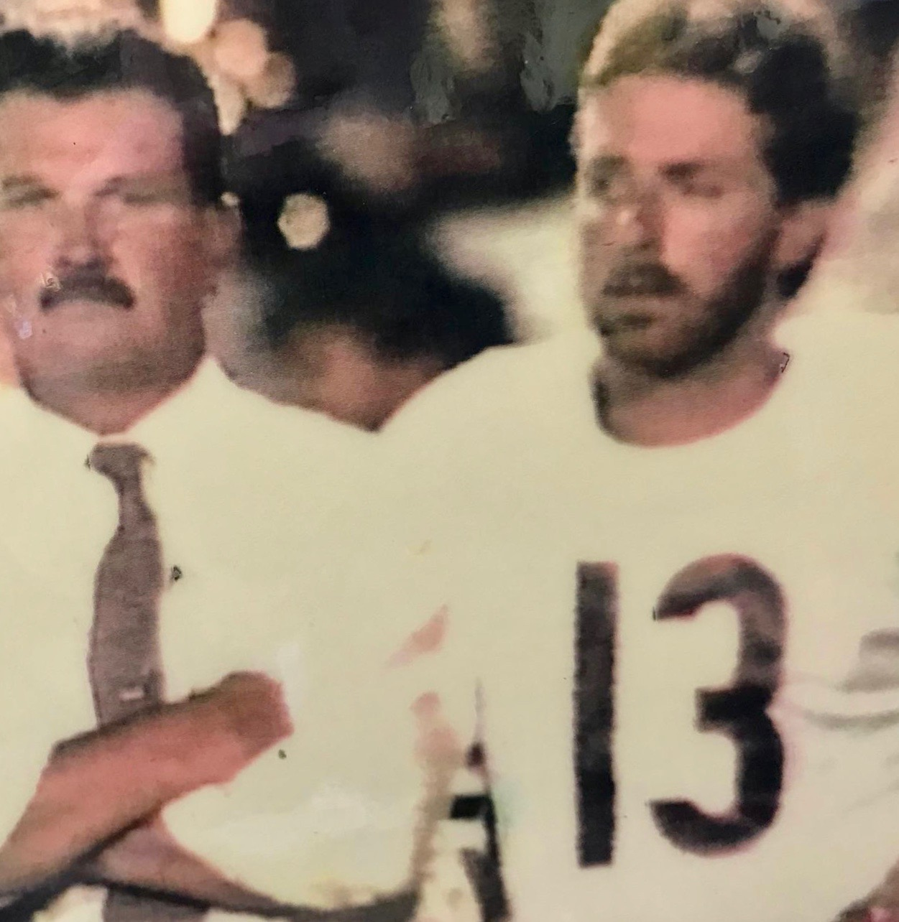
Inducted for Outstanding Contributions as an individual of Central dewitt High School

Slide 3
Biography
Todd is a 1978 graduate and outstanding 4-year, 4-sport athlete. He was a track hurdler and Captain of the basketball team. He was a 3X All-Big Bend Shortstop and once hit 3 homeruns in a game and led the Big Bend in Homeruns (33). He was a 1st Team All-Conference Kicker and still holds 7 program records. He was selected as the Saber Athlete of the Year. He excelled at baseball and football at the University of Dubuque and was elected into their Hall of Fame where he holds 6 Spartan kicking records. He was an MVP Semi-Pro kicker and played with the Chicago Blitz of the USFL and the Arena League. He was signed into the NFL as a free agent by the St. Louis Cardinals and Chicago Bears for camp tryouts, playing with them during the pre-season.

Slide 4
Article from the Observer
TC’s Point After, a former eatery in DeWitt’s downtown, was well known for its tenderloins and prime rib. While munching, patrons may have noticed the Central DeWitt memorabilia adorning the walls. Amongst the decorations was Todd Cox, a 1978 Central DeWitt graduate and four-sport athlete for the Sabers. His parents, Chuck and the late Sally Cox, owned the eatery and weren’t afraid to show their Saber pride and support.
Of course, Todd did his best to earn the support. He was perhaps most well-known for his kicking prowess on the gridiron. His name is next to many kicking records. He’s the holder for most points in one season with 39, points in a career with 69 and most field goals in one season with six. His foot is also entrenched in Saber lore for producing the three longest field goals in Central DeWitt Saber program history.
While his name is etched in the school’s history there, Cox did more than football. He hurdled on the track & field team and was voted team captain of the 1978 Saber boys basketball team.
Cox’s performances on the baseball diamond were also notable. As a sophomore, he led the team in runs batted in and hit .309, which earned him Second-Team All-Conference honors. His final two years of prep sports produced two first-team nods in baseball. During those final two years he

Slide 5
The Observer (cont.)
led the Big Bend conference in home runs with 33, including three blasts in one game. His senior year, 1978, he was selected as the Saber Athlete of the Year.
Cox parlayed all that work in the purple and yellow into post-high school success. He enrolled at the University of Dubuque after graduation and played both football and baseball. As part of the football team, Cox was a three-time conference champion. One game, against Central College, Cox nailed three field goals to propel the Spartans to a conference championship. Cox was a three-year starting kicker for UD and set school records for career points (86), career field goals (30), career punt average (37 yards), extra points in one season (29), field goals in a season (9), and the longest field goal of 51 yards.
He graduated from UD in 1982 with a degree in physical education and is a member of the school’s athletic hall of fame. After college, Cox tried his luck as a professional kicking career. He kicked semi-pro in the Northern States League and was voted special teams MVP of the league when he played for the Racine (Wis.) Gladiators. He also played in USFL for the Chicago Blitz. He played on the first arena football team owned by Jim Foster, a Davenport resident and first commissioner of the Arena Football League.

Slide 6
The Observer (cont.)
He also signed with the Chicago Bears as a free agent in the mid 1980s.
After his kicking heyday was over, Cox became an educator and coach. He was on Dwight Spangler’s — another Saber hall of famer — football staff and also coached for hall of fame basketball coach Neil Padgett.
He is currently in his 31st year teaching special education at North Cedar. He also is a driver’s education instructor and coaches middle school boys and girls basketball as well as varsity boys golf.
Cox loves spending time in the outdoors hunting and fishing. He and his wife, Becky, have three kids: Charlie, Cory, and Cassie.

Slide 7
Induction speech
Inducted for Outstanding Contributions as an Individual
The Cox family is synonymous with the historic sports names in our community. Beyond their connection to the famous TC’s Point After and great tenderloins, if you had ever entered that restaurant you would have immediately witness the family pride in sports accomplishments. One of the brothers, Todd, was a 1978 graduate of Central DeWitt. He was an outstanding 4-year, 4-sport athlete. He was a track hurdler and Captain of the 1978 basketball team. He excelled in baseball and as a Sophomore led the team in RBI’s and hit .309, earning him 2nd Team All-Conference honors. His Junior and Senior years he was selected to the 1st Team All-Big Bend as a Shortstop. During those years he led the Big Bend in Homeruns (33), once hitting 3 homeruns in a game. He was selected as the Saber Athlete of the Year in 1978 during his senior campaign. Football thought, is where he made his mark. He was a 1st Team All-Conference Kicker and helped lead teams to 7-2 and 8-1 records including a Conference Title in 1977. He set program records that still stand today. Season Points (39), Career Points (69), Most Field Goals in a Season (6) Career Field Goals (7) and still has the 3 Longest Field Goals in our school history at 42, 44 and 45 yards. He attended the University of Dubuque and excelled as a 2-sport athlete. He was a tremendous baseball player for the Spartans and held a record for Triples in a Season (5). In football he was part of 3 team Conference Championships and his 3 field goals in a game against Central College

Slide 8
Speech (cont.) & video
propelled the Spartans to one of those titles. He was a 3-year starter and set school records for Career Points (86), Career Field Goals (30), Career Punt Average (37.0) and held single season records for Extra Points (29), Field Goals (9) and Longest Field Goal (51 yards). He was a 1982 graduate and has been elected into the Spartan Hall of Fame. After graduation he pursued NFL opportunities. He kicked Semi-Pro in the Northern States League and was voted the League’s Special Teams MVP for the Racine Gladiators. He was the River Grove Cowboys MVP in their Championship game. He played on Jim Foster’s first Arena Football team and with the Chicago Blitz of the old USFL. He was signed into the NFL by the St. Louis Cardinals and was also later invited to the Chicago Bears training camp, signing as a Free Agent. In 1987 he once again landed tryout with the Bears, playing during their pre-season. He went on to become a high school teacher and coach. He coached football for the Sabers on Hall of Fame Coach Dwight Spangler’s staff and also coached for Hall of Fame basketball coach Neil Padgett. He is currently in his 31th year teaching special needs students and Driver’s Education at North Cedar HS and coaches MS Girls & Boys Basketball and Varsity Boys Golf. He loves the outdoors including hunting, fishing, camping and sports! He is very involved in his children's activities...oldest son Charlie is 23, Cory 18. and Cassie 16. Please help me welcome the newest member of the Central DeWitt High School Hall of Fame, 2018 inductee… Todd Cox.

